Slide 1
Tobacco, Nicotine and Vaping
Chapter 21-22

Slide 2
Tobacco Use
According to the surgeon general, smoking tobacco is the #1 cause of preventable disease and death in the U.S.
What does preventable mean?
Worldwide, smoking causes about 7 million deaths/year (CDC)
Second hand smoke causes more than 41,000 deaths/year in the U.S. (CDC)
On average, people who smoke die 10 years earlier than people who don’t. (CDC)
Tobacco contains nicotine, the addictive drug that is found in tobacco leaves.

Slide 3
Nicotine is an addictive drug, which is a substance that causes physiological and psychological dependence.
Nicotine is also a stimulant which causes an increase in action in the central nervous system, heart, lungs and other organs.
Cigarette smoke is toxic.
Considered a Group A carcinogen- a cancer causing substance.
If smoking continues at the current rate among U.S. youth:
5.6 million of today’s Americans younger than 18 years of age are expected to die prematurely from a smoking-related illness.
This represents about one in every 13 Americans aged 17 years or younger who are alive today. (CDC)

Slide 4
Cigarette smoke also contains tar- a thick and sticky dark fluid produced by burning tobacco.
When tar enters the body, it destroys the cilia (tiny hairs that line the airway to protect from infection), once in the lungs it damages the alveoli (air sacs), inhibiting your ability to absorb oxygen and get rid of carbon dioxide, destroys the lung tissue.
Once lung tissue is damaged you are more likely to get sick from bronchitis, pneumonia, emphysema and cancer.
Cigarettes produce a colorless, odorless and poisonous gas called carbon monoxide.
Carbon monoxide within the body increases the risk of high blood pressure, heart disease, and hardening of the arteries in the heart.

Slide 5
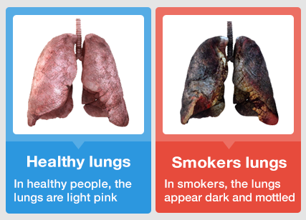

Slide 6
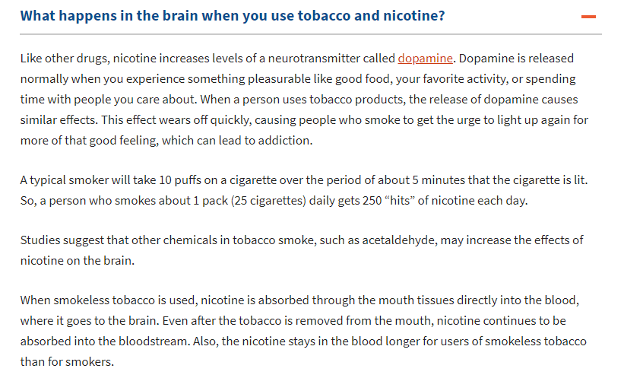

Slide 7
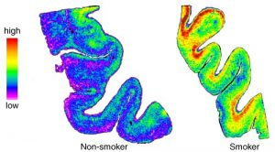
A section of the front of the brain is shown from a non-smoker and a smoker. The number of nicotinic receptors (in yellow and red) is significantly increased in the smoker compared to the non-smoker. (From Perry et al., 1999)
The good news is that the increase in receptor number is probably not permanent. Once one stops using a product containing nicotine, the number of receptors will return to normal pre-nicotine levels—although this could take more than a year. However, immediately after stopping smoking for example, many users experience unpleasant withdrawal symptoms because the brain now has an excess of nicotinic receptors, which are unoccupied. The long process for the brain to recover to normal is one reason why many people who try to quit using nicotine products can’t get past the first year (or even week!) nicotine-free.

Slide 8
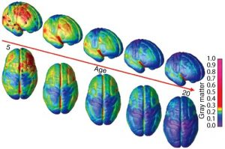
Brain images are shown from age 5 (left side of picture through age 20 (right side of picture). The darker red colors show regions of the brain that are still growing and maturing, with blue regions indicating regions that are fully mature. (Image courtesy of Gogtay, with permission.)
The human brain is not fully mature until the mid-20’s, thus leaving teenagers more vulnerable to developing a nicotine addiction.
The teenage brain is extremely vulnerable to nicotine and other addicting drugs
The teenage brain is particularly vulnerable to drugs such as nicotine and alcohol. These drugs can have much more dramatic consequences on the developing brain than in an adult brain. How do we know this?
Here’s what we know about smoking and human brains: Both adults and teen smokers show increased nicotinic receptors in their brains compared to non-smokers. (https://sites.duke.edu/)

Slide 9
Smoking and the brain
Top 10 Terrible Things Smoking Does to Your Body
How Long Does it Take to Get Addicted to Smoking ?

Slide 10
Reasons why teens become addicted to nicotine more easily than adults:
90% smoking adults begin smoking by age 21, one half of adult smokers are addicted before their 18th birthday.
Every day, 3,200 children between ages 12-17 smoke their first cigarette.
1,300 of those smokers will become addicted, half of these will die from smoking.
If smoking trends remain the same, over 6.4 million current teen smokers will die prematurely from smoking related causes.
Smoking rates are declining in teenagers.
Teen smoking is associated with many other unhealthy activities, such as carrying weapons, trying different drugs, fighting and engaging in high-risk sexual activity.
Smoking teens are three times more likely to drink alcohol, eight times more likely to smoke marijuana, and 22 times more likely to try cocaine.
Teens are more likely to develop a severe addiction to tobacco than if they begin smoking later in life.
50% of smoking teenagers have unsuccessfully tried to quit, failing to break the addiction.
5.6 million children alive today will ultimately die from smoking

Slide 11
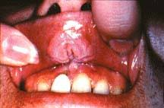
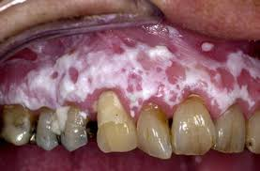
Smokeless tobacco is tobacco that is sniffed through the nose, held in the mouth or chewed.
NOT safe alternatives to smoking cigarettes.
Smokeless tobacco also contains nicotine and contains 28 more carcinogens than cigarettes. All absorbed into the digestive track and mucous membranes.
Due to being held in the mouth for extended periods of time, smokeless tobacco delivers both nicotine and carcinogens at 2-3 times the amount of a single cigarette.
Someone who chews 8-10 dips/day = same amount of nicotine as someone who smokes 2 packs of cigarettes/day.
Smokeless tobacco causes leukoplakia, thickened, white, leathery looking spots on the inside of the mouth that can develop into oral cancer.

Slide 12
Short Term Effects of Tobacco Use
Changes in your brain chemistry
Increased respiration and heart rate
Dulled taste buds and reduced appetite
Bad breath and smelly hair, clothes and skin
Long Term Effects of Tobacco Use
Chronic bronchitis
Emphysema
Lung cancer
Coronary heart disease and stroke

Slide 13
Other consequences you may run into
Legal-
Selling to someone under the age of 18 is illegal, suspension from school.
Social-
Exclusion from social gatherings due to the smell of second hand smoke and the smell of tobacco.
Financial-
Very expensive!
One pack/day can cost up to $2,000/year!
Smoking illnesses cost the U.S more than $300 billion each year
Nearly $170 billion direct health care for adults
$156 billion in loss of productivity
$5.6 billion in loss of productivity due to second hand smoke exposure.

Slide 14
Choosing to live Tobacco Free
Of adults who smoke daily, 87% had their first cigarette by the time they were 18, 95% by the time they were 21.
5.8% of current high school students are smokers (CDC), which is down from 8.1% in 2018.
This is largely due to antismoking campaigns, financial cost, societal pressures and family influence.
Avoiding tobacco use can:
Lower the risk of developing lung cancer
Lower the risk of developing heart disease
Lower the risk of stroke

Slide 15
Prevention Strategies
Choose friend who don’t use tobacco
Avoid situations where tobacco products might be used
Practice and use refusal skills
Reasons to give up tobacco use
Arise in health problems
The desire and will to stop
They realize how expensive it is
There is a high link to alcohol use when you use tobacco
Buying tobacco is illegal if you are under 18 which makes it hard to buy.
Realize the dangers of second hand smoke.

Slide 16
Addiction….
While trying to quit, many people will experience nicotine withdrawal. This is the process that occurs in the body when nicotine, an addictive drug is no longer used.
Many people will find a nicotine substitute helpful. A nicotine substitute is a product that delivers small amounts of nicotine into the users system while he or she is trying to give up the tobacco habit

Slide 17
Promoting a Smoke-Free Environment
Breathing in second hand smoke causes problems for everyone, not just smokers.
Environmental Tobacco Smoke (ETS) is another way of saying second hand smoke. It is air that has been contaminated by tobacco smoke.
ETS is composed of two different types of smoke:
Maintstream smoke- the smoke that is exhaled from the lungs of a smoker.
Sidestream smoke- the side from the burning end of a cigarette, pipe, or cigar.

Slide 18
Effects of smoking on non-smokers
ETS from cigarettes and cigars contains about 4,000 chemical compounds, 43 are identified as carcinogens.
Smoking while pregnant can SERIOUSLY harm the baby.
Nicotine reaches the baby through the placenta
Preterm birth
Low birth weight
Birth defects of the mouth and lip
Increases rate of SIDS-Sudden infant death syndrome.
Smoking around young children can cause a higher rate of sore throats, ear infections, and respiratory problems.
Children who grow up with parents that smoke are 3 times as likely to become a smoker.

