Slide 1
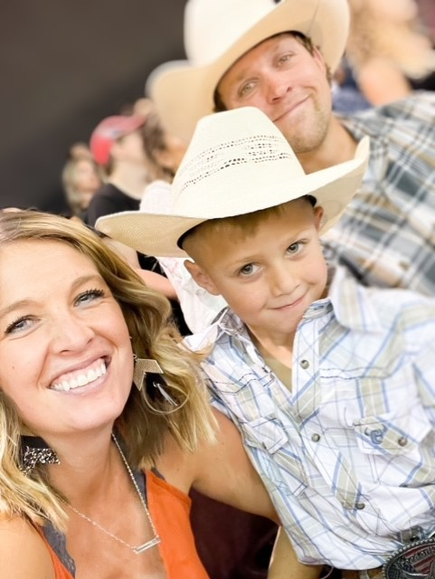
Mrs. Duke
Education:
From Oregon originally
Moved to Nampa to attend NNU
And play soccer (2003).
Received my Masters in Ed Leadership (2012)
FAMILY:
Married for almost 14 years
Dayson is my 7 year old son
2 dogs- Kaiser and Pickle
1 lizard- Sweetie
2 bunnies (we had 3 batches
This summer- 17 at one point!)
- Scooby and Shaggy
10 Chickens
2 cows
Teaching:
1 year elementary PE
2 years at Moses Lake High School
1 year at West Middle
Starting 11 years at Columbia
Hobbies:
Family
Soccer
Camping
Hidden talent:
Blink eyes crazy fast
Clover tongue
Baby cry
Goals for myself (when I was in high school):
My goal was always to be a High school PE/Health Teacher
Play college soccer
Have a family
Receive my Masters
Pet peeve: too many…
Disrespect
Not saying thank you
Not putting carts away
Repeating myself
Swearing
Favorite food:
I love Mexican food!
Specifically chips and salsa
And cheese enchiladas!

