Slide 1
Bell Ringer:
1. How many calories per gram does each of the following nutrients give you?
Protein:
Fat:
Carbohydrates:
Water:
2. Why do we need food labels?

Slide 2
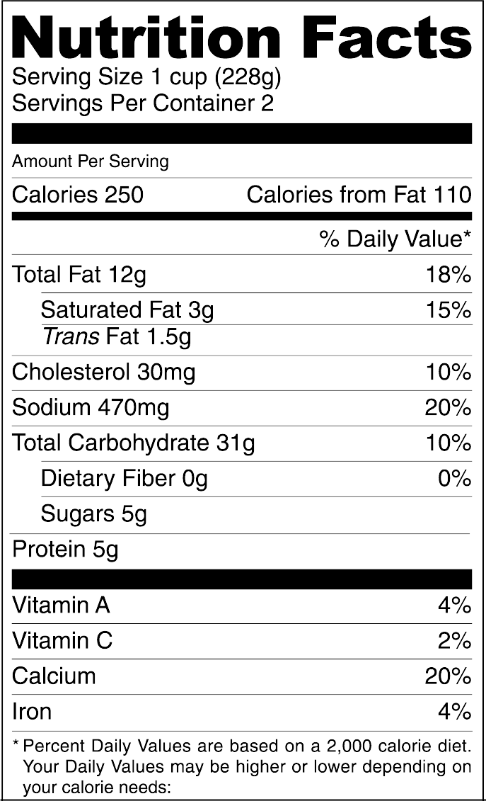
FOOD LABELS!!!
https://www.youtube.com/watch?v=Orj7p3KQcyQ

Slide 3
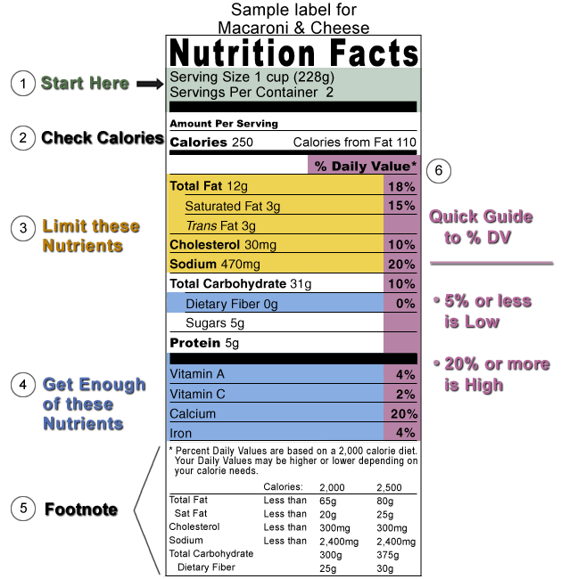
Notes:
Now, take a look at this educational version of the Nutrition Facts label. It identifies the 6 basic messages/skills we seek to communicate to health professionals, educators and consumers.
But Before going into details, let’s just look at this label as if it only had two sections, not 6. Can you identify the two parts and how they differ? The colored section on top (all but #5) contains product-specific information (serving size, calories, and nutrient information) that can vary with each food product.
Now look at the footnote at the bottom of the label. It contains the Daily Values for the nutrients listed and dietary advice generally consistent with the DGA. The footnote, which is not found on smaller product labels, never changes from product to product. I’ll discuss it more later.
…………………………………………………………………………………………………..
OK; Now for the first question: How Many Calories Am I actually Eating?
Many people answer this question by simply looking at the calories listed on the label ? (Not you of course)
So the first thing you want to tell consumers is to look at the serving size AND the number of servings per container: then determine the calories actually consumed.

Slide 4
One or Two Servings?
Single % Double %
Serving DV Serving DV
Serving Size 1 cup (228g) 2 cups (456g)
Calories 250 500
Calories from Fat 110 220
Total Fat 12g 18% 24g 36%
Trans Fat 1.5g 3g
Saturated Fat 3g 15% 6g 30%
Cholesterol 30mg 10% 60mg 20%
Sodium 470mg 20% 940mg 40%
Total Carbohydrate 31g 10% 62g 20%
Dietary Fiber 0g 0% 0g 0%
Sugars 5g 10g
Protein 5g 10g
Vitamin A 4% 8%
Vitamin C 2% 4%
Calcium 20% 40%
Iron 4% 8%
Notes:
In this example, one serving of macaroni and cheese equals one cup. If you ate the whole package, you would eat two cups, which doubles the calories and other nutrient numbers, including the % DVs.
As you can see-The number of servings you consume will determine the number of calories and nutrients you actually eat.
BOTTOM LINE: YOU NEED TO COMPARE HOW MUCH YOU ACTUALLY EAT—NOT ONLY TO THE SERVING SIZE ON THE LABEL BUT ALSO TO THE # OF SERVINGS YOU EAT, TO FIGURE OUT HOW MANY CALORIES (AND NUTRIENTS) YOU ARE CONSUMING.
……………………………………………………………………………….
Next Question: IN TERMS OF CALORIES, WHAT AMOUNT IS LOW, MODERATE OR HIGH?

Slide 5
Limit These Nutrients
The goal is to stay BELOW 100% of the DV for each of these nutrients per day.
Notes:
In answer to the question: Eating too much fat, saturated fat, trans fat, and cholesterol, or sodium may increase your risk of certain chronic diseases, like heart disease, some cancers, or high blood pressure.
So when we say, “Limit These Nutrients,” the goal is to stay BELOW 100% of the DV for each one of these nutrients per day.
Note: Trans fat doesn’t have a %DV: message: Health experts recommend that you keep your intake of saturated fat, trans fat, and cholesterol as low as possible as part of a nutritionally balanced diet.
……………………………………………………………………
So, which nutrients do I need to get in adequate amounts?

Slide 6
Get Enough of These Nutrients
Try to get 100% of the DV for each of these nutrients each day.
Notes:
Consumers can USE the food label not only to help them limit those nutrients they want to cut back on, but also to help them increase those nutrients they need to consume in adequate or greater amounts.
Americans often don't get enough dietary fiber, vitamin A, vitamin C, calcium, and iron in their diets.
EATING ENOUGH OF THESE NUTRIENTS CAN BENEFIT YOUR HEALTH AND HELP REDUCE THE RISK OF SOME DISEASES AND CONDITIONS.
For example, getting enough calcium may REDUCE THE RISK OF OSTEOPOROSIS, a condition that results in brittle bones as one ages (More on this later). You can also address the benefits of a HIGH-FIBER DIET: FOR EXAMPLE, IMPROVED LAXATION, INCREASED SATIETY, AND THE POSSIBILITY OF REDUCED RISK OF HEART DISEASE , particularly when the fiber is soluble and the diet is low in saturated fat and cholesterol.
…………………………………………………………………………………………………
Now let’s look at the footnote—Why is it relevant? You don’t have to know this information but frankly, understanding what the %DV is based on increases the chance people will use it.

Slide 7
The Footnote
Notes:
This is the footnote that you see on the bottom of larger food packages.
Can you tell which column lists the Daily Values? Maybe you can tell, but most people can’t.
What are these DVs? They represent expert advice for upper daily limits (for total fat, sat fat, cholesterol, and sodium), based on a a 2,000 calorie diet.— But for Total Carbohydrates and dietary fiber, they represent lower daily limits— Public health experts advise us to stay within these limits, ie dietary recommendations, per day for a 2,000 calorie.
Still confused?

Slide 8
The Percent Daily Value
The % DV is based on 100% of the daily value for each nutrient.
Notes:
The %DV tells you IF A SERVING OF FOOD IS HIGH OR LOW IN A NUTRIENT. THE % DV COLUMN DOES NOT ADD UP VERTICALLY TO TOTAL 100%.
INSTEAD, EACH NUTRIENT WITH A % DV (e.g.,, fat, cholesterol sodium, vitamin c, calcium etc.) IS BASED ON A 100% OF THE DAILY REQUIREMENTS (OR THE DV) FOR THAT NUTRIENT for a 2,000 calorie diet
-----------------------------------------------------------------------
HOW CAN YOU TELL IF the %DV IS HIGH OR LOW?

Slide 9
No % Daily Value
Trans Fat
Sugars
Protein
Notes:
As you can see, there are three nutrients that have no % DV (for TRANS & SUGARS, THERE ARE NO DAILY VALUES RECOMMENDATIONS FOR THEM.)
For Protein: Unless a claim is made, or the food is meant for use by infants and children under 4 years old, there is no requirement for a % DV for protein. Current scientific evidence indicates that protein intake is not a public health concern for adults and children over four years old.
Trans fat: Scientific reports link trans fat (saturated fat and cholesterol) with raising LDL (“bad”) blood cholesterol, which increases your risk of coronary heart disease, a leading cause of death in the US. However, experts could not provide a reference value for trans fat nor any other information that FDA believes is sufficient to establish a DV or % DV.
***************************************
Now let’s discuss sugars, including added sugars.

Slide 10
Read the Nutrition Facts Label For Total Sugars
Plain Yogurt
Fruit Yogurt
Notes:
Although sugars have no % DV, you can know how to limit your intake by comparing two products and choosing the one with the lowest amount.
To compare, look at the Nutrition Facts label to determine the TOTAL amount of sugars in a food. THE TOTAL AMOUNT INCLUDES BOTH NATURALLY-OCCURRING SUGARS AND THOSE SUGARS ADDED TO THE FOOD.
In this case, the plain yogurt on the left has 10g of sugar in one serving; the fruit yogurt on the right has 44g of sugars, 2-3 times the amount of sugar found in most candy bars.
……………………………………………………………………………………..
So how can you tell if either of these yogurts has added sugars?

Slide 11
Look at the Ingredient List for Added Sugars
Plain Yogurt
INGREDIENTS: CULTURED PASTEURIZED GRADE A NONFAT MILK, WHEY PROTEIN CONCENTRATE, PECTIN, CARRAGEENAN.
Fruit Yogurt
INGREDIENTS: CULTURED GRADE A REDUCED FAT MILK, APPLES, HIGH FRUCTOSE CORN SYRUP, CINNAMON, NUTMEG, NATURAL FLAVORS, AND PECTIN. CONTAINS ACTIVE YOGURT AND L. ACIDOPHILUS CULTURES
Notes:
To find if sugars and caloric sweeteners have been added, you need to look at the ingredient list. Notice that ingredients are listed in descending order, so that those ingredients listed first weigh the most, while those weighing the least come last.
What is the difference between these two lists of ingredients regarding sugars? For the plain yogurt listed on top, No added sugars or sweeteners are listed in the ingredients, yet 10g of sugars were listed on the Nutrition label. This is because, there are no added sugars, only naturally-occurring ones in plain yogurt.
If you are concerned about your intake of sugars, especially added sugars, make sure that they are not one of the first two or three ingredients listed. Some other NAMES FOR ADDED SUGARS INCLUDE: corn syrup, high-fructose corn syrup, fruit juice concentrate, maltose, dextrose, sucrose, honey, and maple syrup.
_______________________________________________
The last nutrient I would like to bring to your attention is calcium.

Slide 12
Different Names for Sugar:
Agave nectar
Barley malt syrup
Beet sugar
Brown sugar
Buttered syrup
Cane juice/sugar
Caramel
Coconut sugar
Coconut palm sugar
Corn syrup/sweetener
Corn syrup solids
Confectioner’s sugar
Dehydrated cane juice
Dextran
Dextrose
Evaporated cane juice
Free flowing brown sugars
Fructose
Fruit juice
Fruit juice concentrate
Galactose
Glucose
Golden sugar
Golden syrup
High-fructose corn syrup
Honey
Lactose
Maltodextrin
Maltol
Maltose
Malt syrup
Molasses
Rice syrup
Sorbitol
Sorghum syrup
Sucrose
Sweet sorghum
Syrup

Slide 13
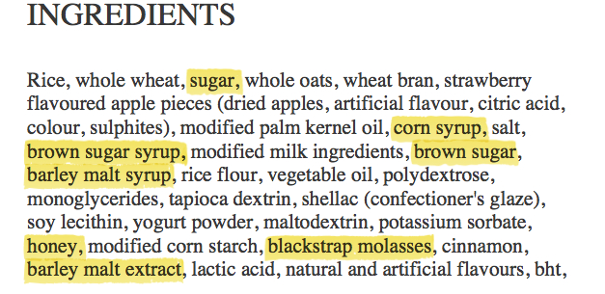

Slide 14
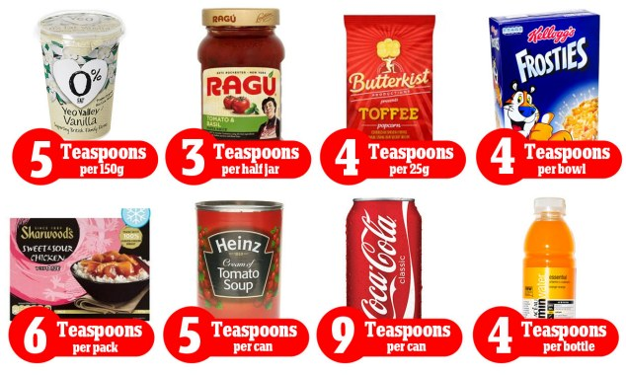

Slide 15
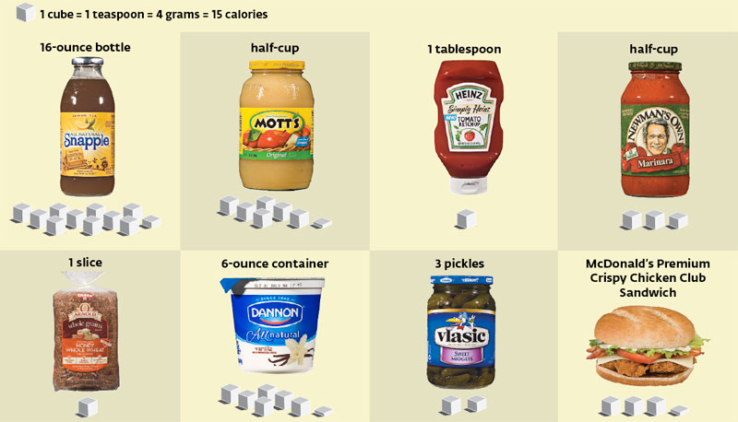

Slide 16
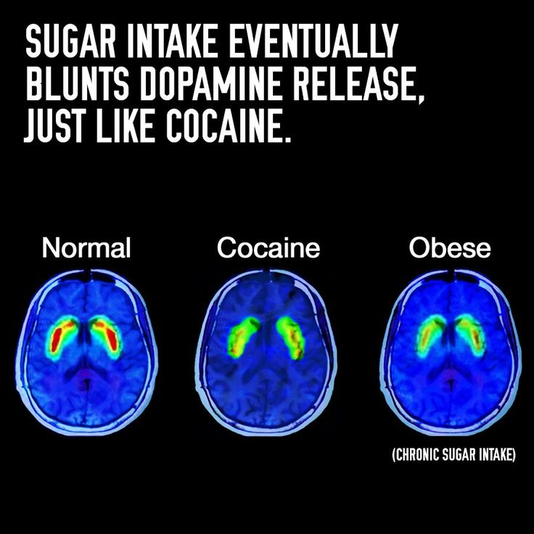

Slide 17
https://www.youtube.com/watch?v=JEA-G9m9S0Y

Slide 18
Practice!

Slide 19
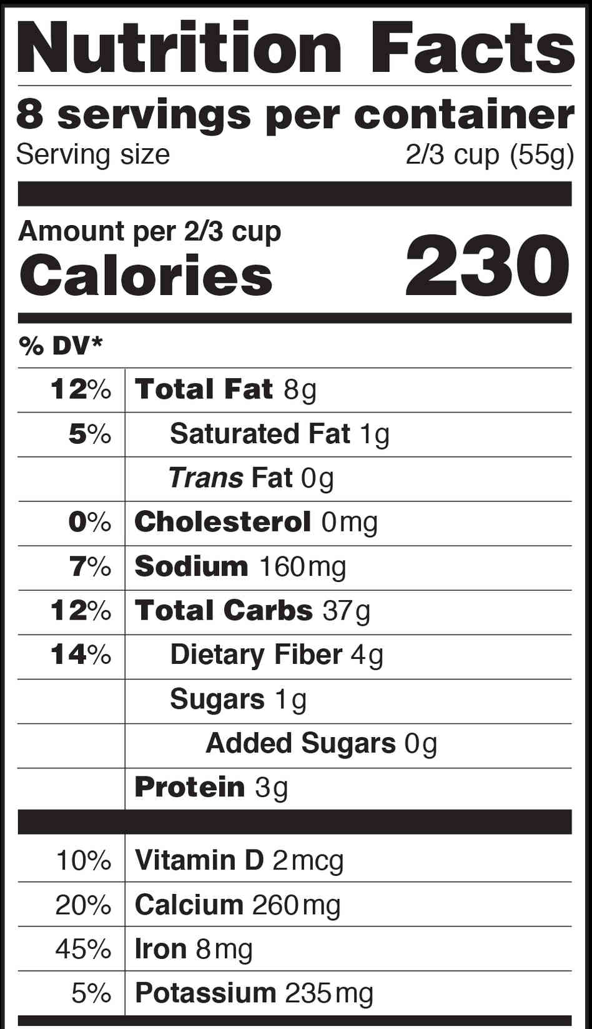
I ate 1 serving of this food…
How many servings did I eat? 1
How many grams of these nutrients are there?
Fat: 8g
Carbs: 37g
Protein: 3g
Multiply these numbers by their cal/g number (9,4,4)
Fat: 72cal
Carbs: 148cal
Protein: 12cal
This equals the number of calories that each nutrient gave you!!! 232cal per serving!!!!

Slide 20
I ate all 8 servings of this food…
How many servings did I eat?
8
How many grams of these nutrients are there?
Fat: 8g
Carbs: 37g
Protein: 3g
Multiply grams by the # of servings you eat.
Fat: 8g x 8 servings= 64g
Carbs: 37x8= 296g
Protein: 3x8= 24g

Slide 21
Grams X # of servings eaten
Fat: 64g
Carbs: 296g
Protein: 24g
Multiply these numbers by their cal/g number (9,4,4)
Fat: 64x9= 576 cal
Carbs: 296x 4= 1184 cal
Protein: 24x4= 96 cal
Total= 1,856/2000
93%

Slide 22
This time we only ate 2.5 servings…
How many servings did I eating?
2.5
How many grams of these nutrients are there?
Fat: 8g
Carbs: 37g
Protein: 3g
Multiply grams by the # of servings you eat.
Fat: 20g
Carbs: 92.5g
Protein: 3x2.5 = 7.5

Slide 23
Grams X # of servings eaten
Fat: 20g
Carbs: 92.5g
Protein: 7.5g
Multiply these numbers by their cal/g number (9,4,4)
Fat: 180cal
Carbs: 92.5x4= 370cal
Protein: 7.5x4= 30 cal

Slide 24
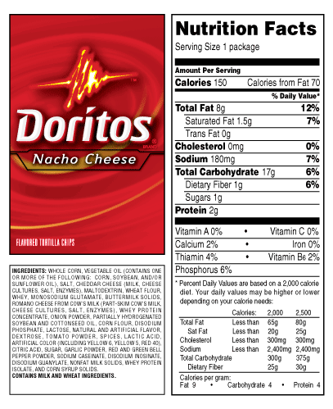

Slide 25
Your turn to practice!
Do the worksheet on your own
Pay attention to the number of servings on each label!!!
After you finish:
Grab 2 food cards and find out how many calories you would consume from fat, carbs, and protein if you were to eat 1, 2.5, and 4 servings of them!!!

Slide 26
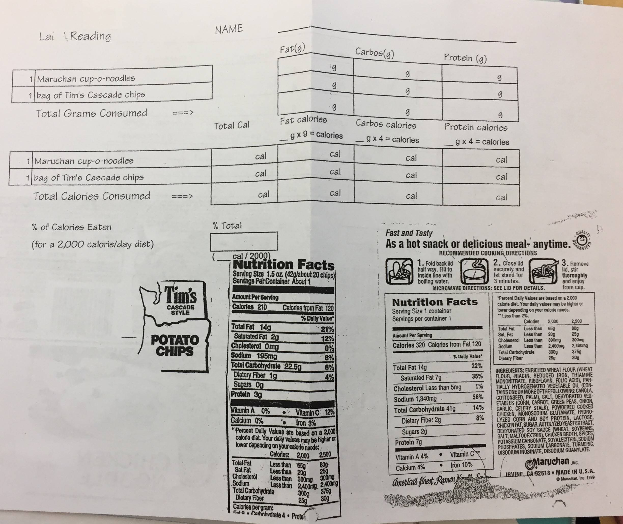

Slide 27
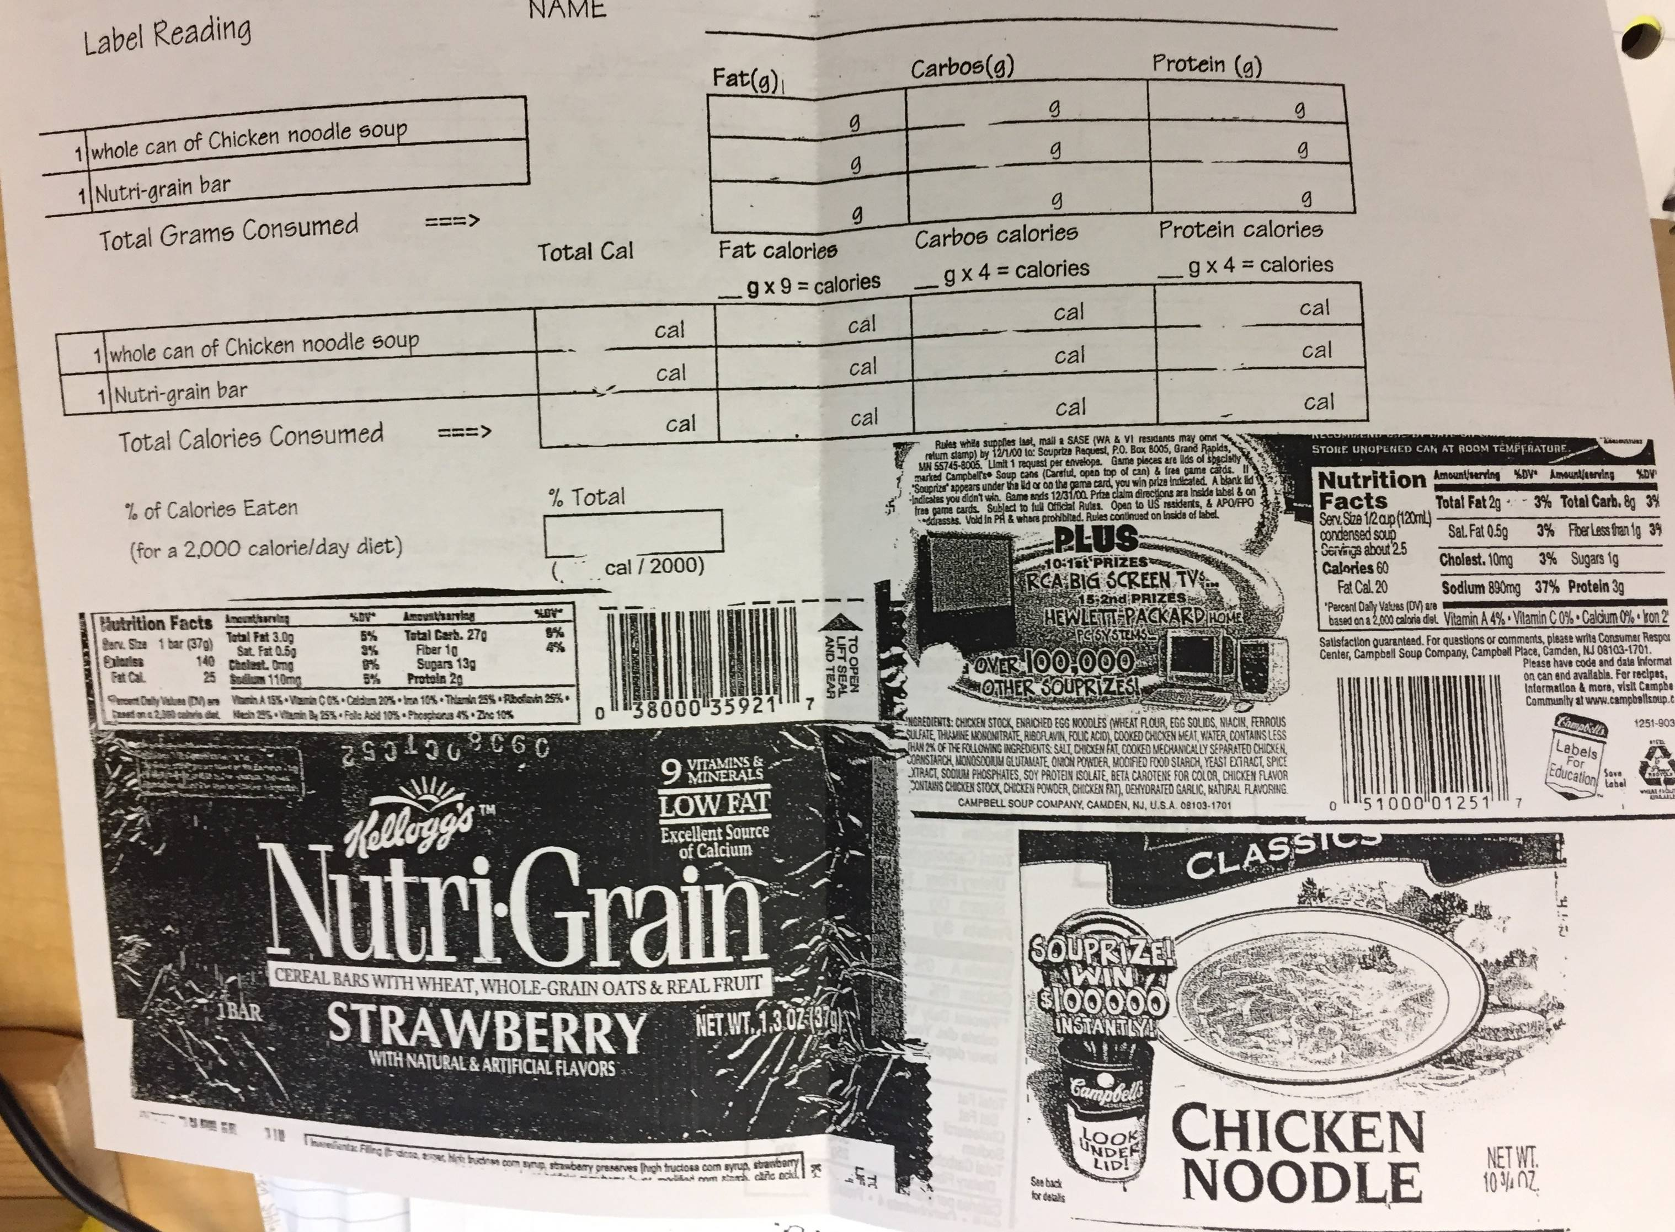

Slide 28
Did you get it right? Questions? PLEASE contact me and ask!

