Slide 1
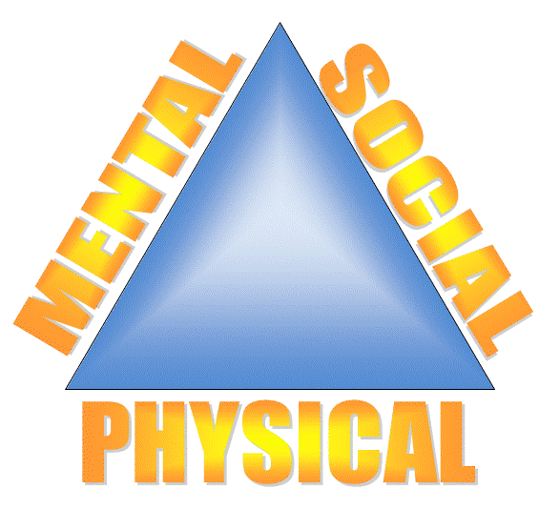
The Health Triangle
Physical, mental/emotional and social- are interconnected, like the sides of a triangle.
When one side receives too much or too little attention, the whole triangle can become lopsided or unbalanced (we feel “off”)
To truly maintain health, your goal is to keep all 3 sides balanced by giving each area equal attention and being able to recognize when one side is receiving too much/or too little attention.
This Photo by Unknown Author is licensed under CC BY-SA-NC

Slide 2
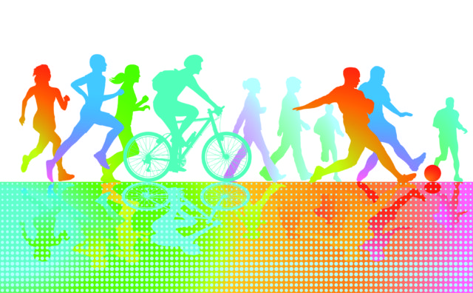
Physical
Your physical health has to do with how well your body functions.
When in good physical health you:
have enough energy to perform the activities in your daily life
Cope with everyday challenges and stresses
Get enough sleep/rest
Eat nutritious foods
Drink enough water
Physically active on a regular basis
Also includes paying attention on what you put into your body and avoiding harmful substances.
This Photo by Unknown Author is licensed under CC BY-SA

Slide 3
Mental/Emotional
Your feelings about yourself, how well you meet the demands of daily life, and the ability to process information .
People with GOOD M/E health enjoy challenges, accept responsibility for their actions and stand up for their beliefs and values.
People with GOOD M/E health are confident with their feelings and can express them appropriately.
Can see positives out of negatives
Can move on from daily stresses rather than dwelling
This Photo by Unknown Author is licensed under CC BY-SA

Slide 4
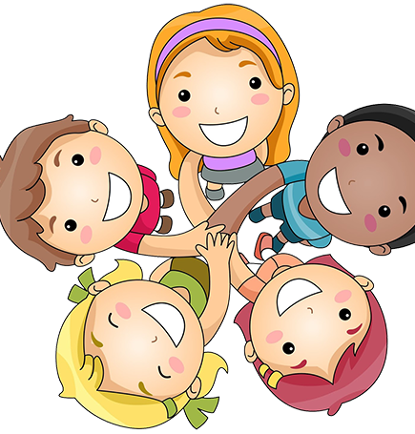
Social
Involves the way you get along with others.
Includes your ability to make and keep friends.
Involves communicating well and showing respect and care for yourself and others.
This Photo by Unknown Author is licensed under CC BY-NC

Slide 5
This Photo by Unknown Author is licensed under CC BY-NC

Slide 6
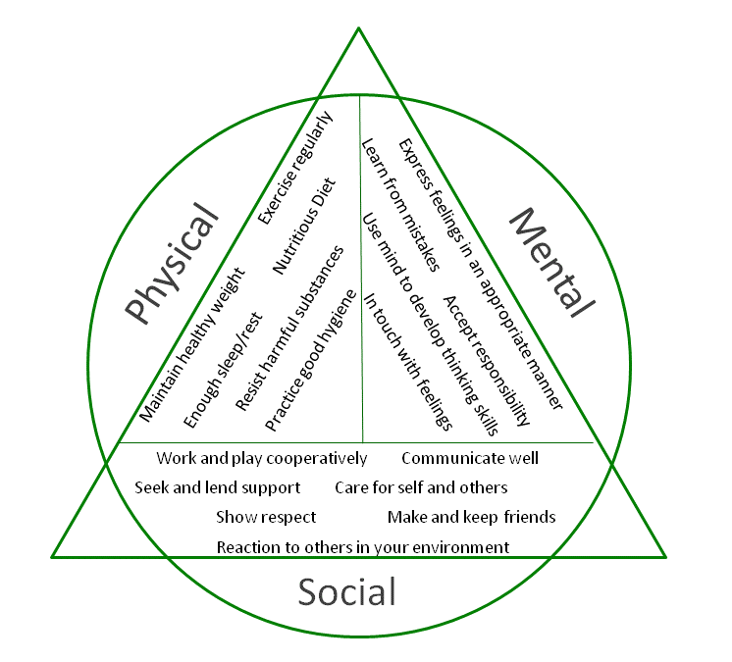
This Photo by Unknown Author is licensed under CC BY-NC-ND

Slide 7
Think about….
How does being hungry affect the health triangle?
How does not getting enough sleep affect the health triangle?
Fighting with your parents?
Being stressed about a test?
Interviewing for a job?
When we were in school online?
This Photo by Unknown Author is licensed under CC BY-SA-NC

