Slide 1
Mental Disorders
A Mental Disorder is an illness of the mind that can affect the thoughts, feelings, and behaviors of a person, preventing him or her from leading a happy, healthful, and productive life.
1 in 5 US adults live with a mental disorder that is 46.4% (2019)
Approximately one in five teens (aged 12 to 18) suffer from at least one mental health disorder.
Of the 20% of children and adolescents who suffer from mental health problems, only one-third receive the help they need. (2019)
Some don’t seek help because of the Stigma, mental illness can have.
Stigma is a negative label.

Slide 2
Classifications of Mental Disorders
Organic Disorder - is caused by a physical illness or an injury that affects the brain.
Examples: Brain tumors, infections, chemical imbalances, exposure to drugs and toxins, or injuries resulting in brain damage.
Functional Disorder- has a psychological cause and does not involve brain damage.
Examples: Heredity, stress, emotional conflict, fear, ineffective coping skills, or other conditions.
Often functional disorders are tied to disturbing events in childhood, such as abuse, serious illness, or a traumatic death in the family.

Slide 3
Types of Mental Disorders
Anxiety Disorders
Mood Disorders
Eating Disorders
Conduct Disorders
Schizophrenia
Personality Disorders
6 categories.

Slide 4
Anxiety Disorders
Anxiety Disorder- A condition in which real or imagined fears are difficult to control. An anxiety disorder is characterized by chronic fear. ***About 4 million Americans suffer from an anxiety disorder.
4 types of anxiety disorders
Phobia
Obsessive Compulsive Disorder
Panic Disorder
Post-Traumatic Stress Disorder

Slide 5
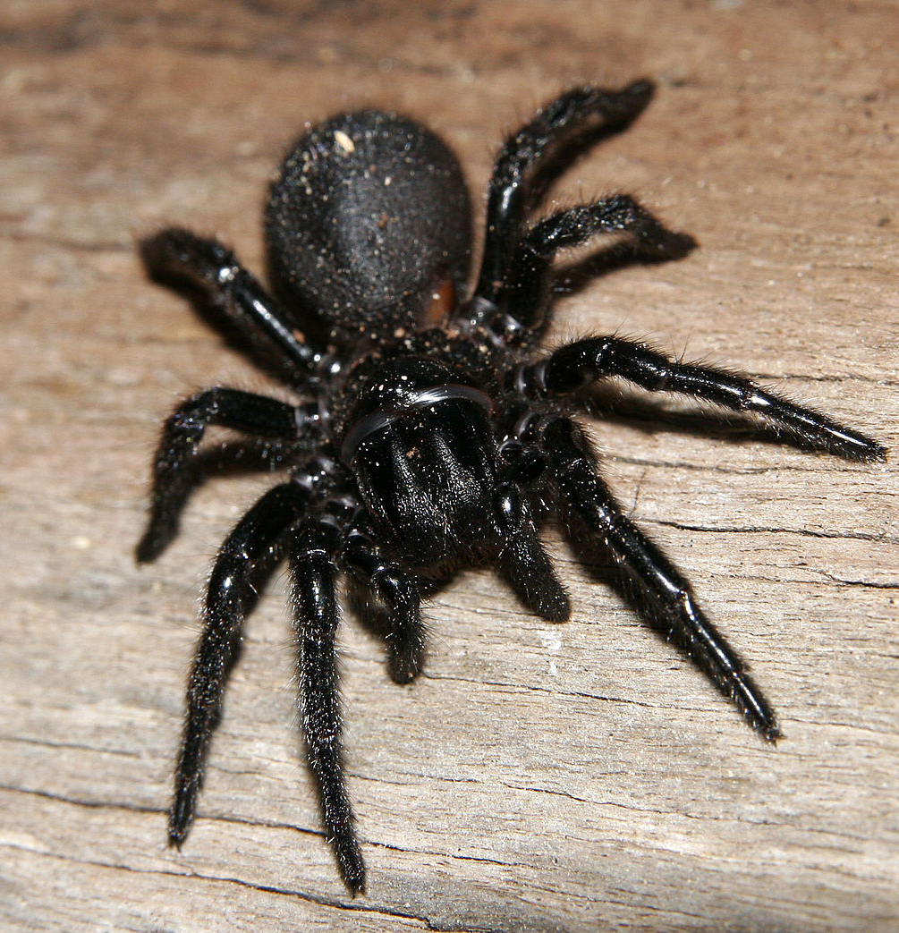
Phobia--- Is an anxiety disorder
Phobia is a strong and irrational fear of something specific
What are some things you all might be afraid of?
People with phobias do everything they can to avoid the object of the their fear. As a result , a person with a phobia may be unable to live a normal life.
https://www.youtube.com/watch?v=1h3Dh5QAD7w
https://www.youtube.com/watch?v=JDvDCqLCdEE
Here is a big list of phobia’s that people are known to have:
This Photo by Unknown Author is licensed under CC BY-SA

Slide 6
Phobia List
Pyrophobia- A fear of fire
Aerophobia- A fear of flying
Zoophobia- A fear of animals
Hematophobia- A fear of blood
Ailurophobia- A fear of cats
Demophobia- A fear of crowds
Nyctophobia- A fear of the dark
Thanatophobia- A fear of death
Mysophobia- A fear of dirt
Batrachophobia- A fear of frogs
Belonephobia- A fear of needles
Algophobia- A fear of pain
Ophidiophobia- A fear of snakes
Arachnophobia- A fear of spiders
Xenophobia- A fear of strangers
Phobophobia- A fear of phobias
Panphobia- A fear of everything
Astraphobia- A fear of thunder and lightning
Bathophobia-A fear of depth
Dromophobia- A fear of crossing the streets
Haptephobia-A fear of being touched
Sistophobia-A fear of eating and food
Taphephobia- A fear of being buried alive
Bibliophobia-A fear of books
Claustrophobia- A fear of closed spaces
Murophobia---A fear of mice

Slide 7
Obsessive Compulsive Disorder –an anxiety disorder
A person with Obsessive Compulsive Disorder or (OCD) is trapped in a pattern of repeated thoughts or behaviors.
Obsessive refers to the persistent, recurrent, and unwanted thought that prevent people from attending normal daily activities.
Compulsive refers to repeated, irresistible behaviors.
Examples of OCD: excessive hand washing, color coded everything…What are some others you may know of?
https://www.youtube.com/watch?v=UWiQUzwLv_I

Slide 8
Panic Disorder- an anxiety disorder
A person with panic disorder has sudden, unexplained feelings of terror.
These Panic Attacks are accompanied by symptoms such as trembling, a pounding heart, shortness of breath, or dizziness.
Panic attacks often are triggered by a particular object, condition or situation.
https://www.youtube.com/watch?v=YxELZyA2bJs

Slide 9
Post Traumatic Stress – an anxiety disorder
Post traumatic stress is a condition that may develop after exposure to a terrifying event that threatened or caused physical harm.
Common after:
Personal assault
Natural or human made disasters (earth quakes or bombings)
Car accidents
Military combat
Can start weeks or months after the event that caused it.

Slide 10
Mood Disorders
2 Most common mood disorders
Clinical Depression
Bipolar Disorder
A mood disorder is an illness, often with an organic cause, that involves mood extremes that interfere with everyday living.
Mood disorders are extreme in both intensity and duration.
Notes:
Remind students what organic means: Organic Disorder - is caused by a physical illness or an injury that affects the brain

Slide 11
Clinical Depression- a mood disorder
Clinical depression results from a chemical imbalance that a person cannot over-come without professional help.
The feelings of hopelessness, sadness, or despair that lasts more than a few weeks and interferes with daily interests and activities.
It can effect:
Work
Sleep
Ability to concentrate
Ability to perform at school

Slide 12
Bipolar Disorder- a mood disorder
Manic has extreme “highs”
Depressive has extreme “lows”
See figure 9.1 in the book pg 227
Also known as Manic-Depressive disorder, is marked by extreme mood changes, energy levels, and behavior.

Slide 13
Eating Disorders https://www.youtube.com/watch?v=CVifJ6I-i7g
Psychological pressures, possible genetic factors, and an obsession with body image and thinness can lead to an eating disorder.
Anorexia- abstaining from eating food and Bulimia-some form of binging and purging suffer from life-threatening disturbances in eating behavior. Eating disorders not a failure of will or behavior; they are real, treatable medical illnesses.
Complications include:
Serious heart conditions
Kidney failure
Lining of esophagus deterioration

Slide 14
Conduct Disorders
Conduct disorder refers to a group of repetitive and persistent behavioral and emotional problems in youngsters. Children and adolescents with this disorder have great difficulty following rules, respecting the rights of others, showing empathy, and behaving in a socially acceptable way.
Examples: lying, theft, aggression, violence, arson, vandalism
People act on impulses towards others in destructive ways.

Slide 15
Schizophrenia
Schizophrenia is a serious mental disorder in which people lose touch with reality. Schizophrenia may result in some combination of hallucinations, delusions, and extremely disordered thinking and behavior that impairs daily functioning, and can be disabling. People with schizophrenia require lifelong treatment.
“A Beautiful Mind”

Slide 16
Personality Disorders
Personality disorders are a group of mental illnesses. They involve long-term patterns of thoughts and behaviors that are unhealthy and inflexible. The behaviors cause serious problems with relationships and work. People with personality disorders have trouble dealing with everyday stresses and problems. They often have stormy relationships with other people.
The cause of personality disorders is unknown. However, genes and childhood experiences may play a role.
Examples:
Borderline Personality Disorder
Narcissistic Personality Disorder
Paranoia and Delusional Disorder
Schizoid Personality Disorder
Passive-aggressive personality disorder
Borderline personality disorder
Antisocial personality disorder

