Slide 1
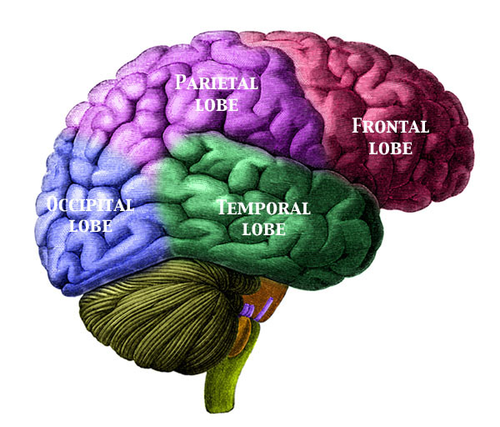
Achieving Good Mental Health ch.7
This Photo by Unknown Author is licensed under CC BY-SA

Slide 2
1) Mental/Emotional Health is the ability to accept yourself and others, adapt to and manage emotions, and deal with the demands and challenges you meet in life.
Characteristics of GOOD M/E Health:
Positive self-esteem- confident in yourself
Sense of belonging- having an emotional attachment to family/peers/coaches/teachers, provides comfort and assurance.
Sense of purpose- recognizing your own value and importance. Setting and achieving goals, hobbies.
Positive outlook- seeing the bright side and finding positives.
Autonomy- having the confidence to make responsible and safe decisions promotes self-assurance and a sense of independence.

Slide 3
Realistic about their strengths and weaknesses
Responsible for their personal behavior
Avoid high-risk behaviors (tobacco, alcohol, drugs, no texting when driving)
Are open minded and flexible, able to see several sides to an issue
Are fun loving and able to relax alone or with others
Respect both their own needs and the needs of others.
Respect each person’s value as a human being- including their own
Invest time and energy in developing healthy relationships with people.
Express their emotions in ways that do not hurt themselves or others.
Put their talents and abilities to good use
View change as a challenge and an opportunity.
Turn to a partner and tell them one thing you think you are good at when it comes to having positive Mental/Emotional health, name one thing you need to work on.

Slide 4
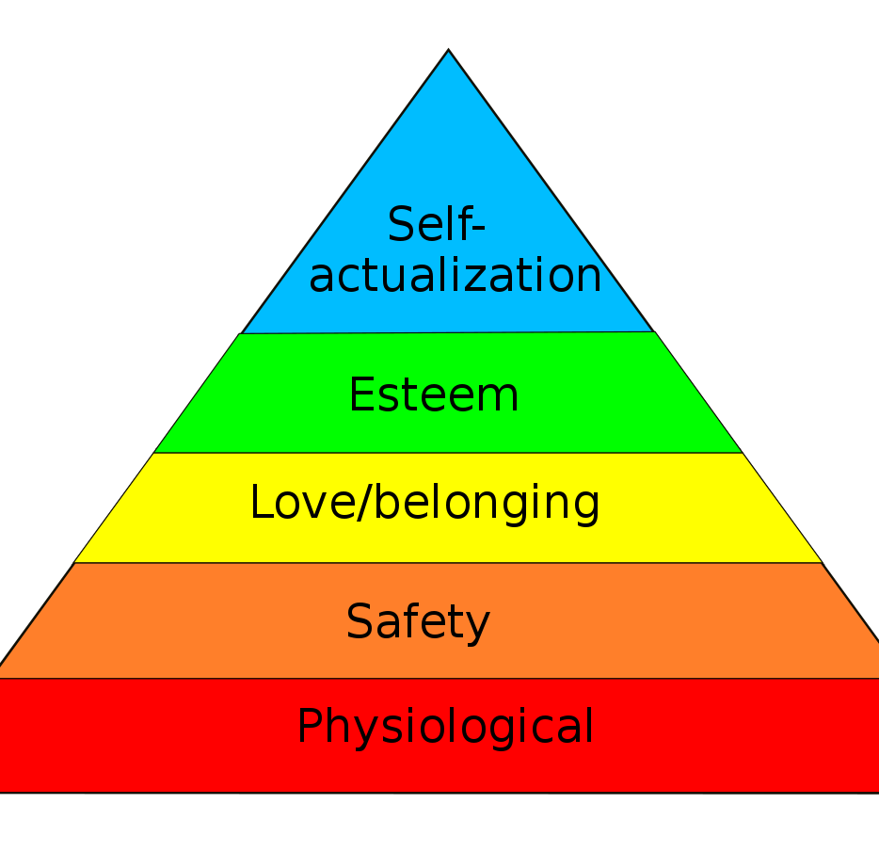
2) Hierarchy of Needs- is a ranked list of those needs essential to human growth and development starting from basic needs, and building toward reaching your highest potential.
A) Physical needs- basic needs of hunger, thirst, sleep, shelter
B) Need for safety- feeling secure at home, with family/friends, school.
C) Need to be loved and belong- give love and loved in return (babies who are denied emotional attention may be stunted mentally).
D) Need to be valued and recognized- appreciated and supported by family and friends (ex: a simple thank you, a pat on the back).
E) Need to reach your potential- Self-actualization- the striving to become the best you can be.
It is important to note that someone who does not receive these levels CAN still reach their highest potential… it is just a lot more challenging than others who achieve each level.
Take 30 seconds and think to yourself about these levels
This Photo by Unknown Author is licensed under CC BY-SA

Slide 5
3) Personality- is a complex set of characteristics that makes you unique.
3 main influences that make up your personality:
Personality and heredity- (inherited traits like intellectual abilities and temperament or emotional tendencies). This does not mean you have no control over how successful you become or what you do.
Personality and environment- includes everything around you in your day to day life. Family, friends, home, object, event, activity. Can include role models.
Personality and behavior- You have control over this. It is how you make decisions, what decisions you make and what actions you take.

Slide 6
The Color Personality Test C:\Users\sduke\OneDrive - Nampa School District\Health\General Health\Color Test.docx
This Photo by Unknown Author is licensed under CC BY-NC

Slide 7
When learning… (I am not saying these descriptions are 100% correct, but you should see a resemblance).
GOLD- when learning….
Likes chronological order
Likes when objectives are clearly stated
When teachers acknowledge their work
Receives compliments on their quality of work
When teachers allow for additional time
Enjoys leadership positions
GREEN- when learning….
Listen attentively to ideas
Likes when teachers offer positive specific feedback
Like to work independently
Likes when teachers validate their thoughts and ideas

Slide 8
ORANGE-
Like to receive recognition and honest critique
Likes positive feedback and specific feedback
Likes variety
Enjoys tangible rewards
BLUE-
Enjoy personal and individual recognition
Simple “hello’s”
Enjoys harmonious environment
Enjoys verbally expressing what they know
Choose what they are doing very carefully and precisely, thinking about others.

Slide 9
How Golds see themselves
Firm, conservative, strong willed, having a view, orderly, realist, stable, directive, moral standards, assertive
How others MIGHT see golds (this does not mean this is how you are)
Rigid, boring, stubborn, opinionated, predictable, bossy, judgmental, controlling
This Photo by Unknown Author is licensed under CC BY-SA

Slide 10
How greens see themselves:
Confident, firm minded, under control, calm, visionary, intelligent, independent, perfectionist, creative, determined
How others may see greens (again, does not mean this is how you are)
Arrogant, no mercy, unrealistic, unemotional, intellectual snob, devalue relationships, critical, heartless
This Photo by Unknown Author is licensed under CC BY-SA

Slide 11
How oranges see themselves:
Carefree, adventurous, charming, energetic, bold, impulsive, enjoys change
How others MAY see oranges
Flaky, rule breaker, manipulative, uncontrollable, obnoxious, irresponsible ,off task, indecisive, distracted

Slide 12
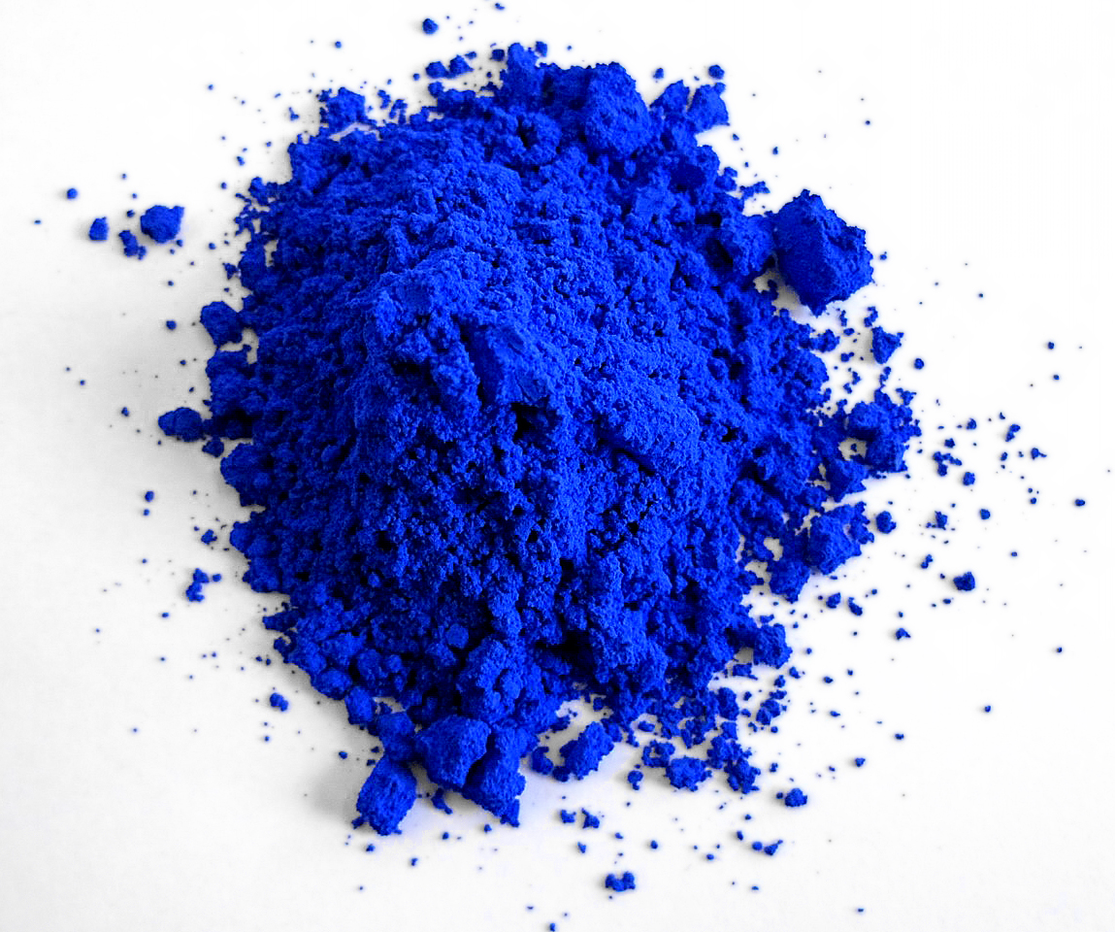
How blues see themselves
Compassionate, trusting, romantic, affectionate, caretaker, sympathetic, sensitive, nurturing, passionate
How others MAY see blues
Naiive, mushy, touchy-feely, smothering, stuck in the past, push-over, emotional
This Photo by Unknown Author is licensed under CC BY-SA

Slide 13
When it comes to listening styles for each color
Blue- during conversations a blue is focusing on more than just the words, they are attending to the meaning behind the message. They evaluate what they see, hear and feel is being communicated. (The BEST listeners, go to blues when you are having a hard day)
Gold- golds listen for details-in order. They can lost their train of thought if the conversation is interrupted or a person speaks off target. They like a well planned, direct plan. They listen for what their responsibility is “what is by duty? What do I need to get done?
Orange- listen for entertainment, impact, relevance, and usefulness. Unless you are incredibly engaging or reveal immediately how the information you are conveying is useful to an orange, they may lose interest, especially if lengthy. They are thinking about how they can connect to the speaker while the speaker is talking. “squirrel”
Green- listen for information and want to know the purpose for the communication. Often, they assume the communicator has approached them to solve a problem. They tune our emotion and subjects that are little interest to them. Focus on finding the solution. (Green’s are not great listeners, they tend to lack empathy and want to solve the problem)

Slide 14
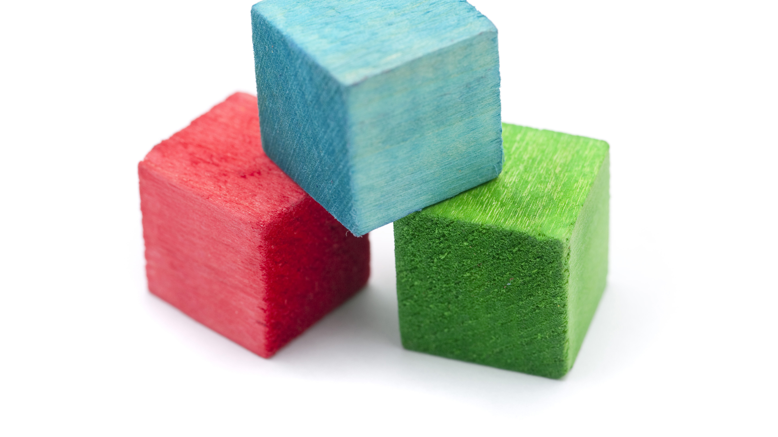
4) Personal Identity- is your sense of yourself as a unique individual.
Identity- who you are Personality-how you act
5) Developmental assets- are the building blocks of development that help young people grow up as healthy, caring, responsible adults.
This Photo by Unknown Author is licensed under CC BY

Slide 15
Developmental Assets
1) Support- from family, friends, teachers, coaches, environments
2) Empowerment- being valued by adults in the community and feeling safe at home.
3) Boundaries and expectations- clear rules and clear consequences.
4) Constructive use of time- being involved in activities, sports, reading, baking, etc.
5) Commitment to learning- being motivated to achieve.
6) Positive values- compassion, loyal, trustworthy, honest, responsible and practicing what you preach.
7) Social competencies- planning and decision making, communication, having knowledge and tolerance of other cultures and opinions, conflict resolution skills.
8) Positive identity- self esteem, sense of purpose, positive view on life.

Slide 16
Working toward a healthy identity
Recognize
Recognize your strengths AND weaknesses
Demonstrate
Demonstrate positive values
Develop
Develop a purpose in life
Form
Form meaningful relationships
Contribute
Contribute to your community
Avoid
Avoid unhealthful risk behaviors

Slide 17
Understanding your emotions…
6) Emotions- are signals that tell your mind and your body how to react. Aka “feelings”
Hormones- a chemical secreted by your glands that helps regulates our emotions.
boys- testosterone girls-estrogen

Slide 18
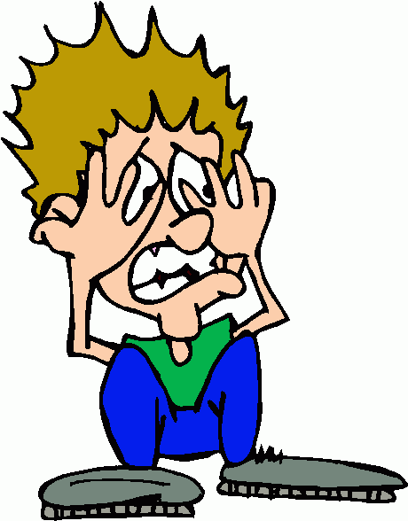
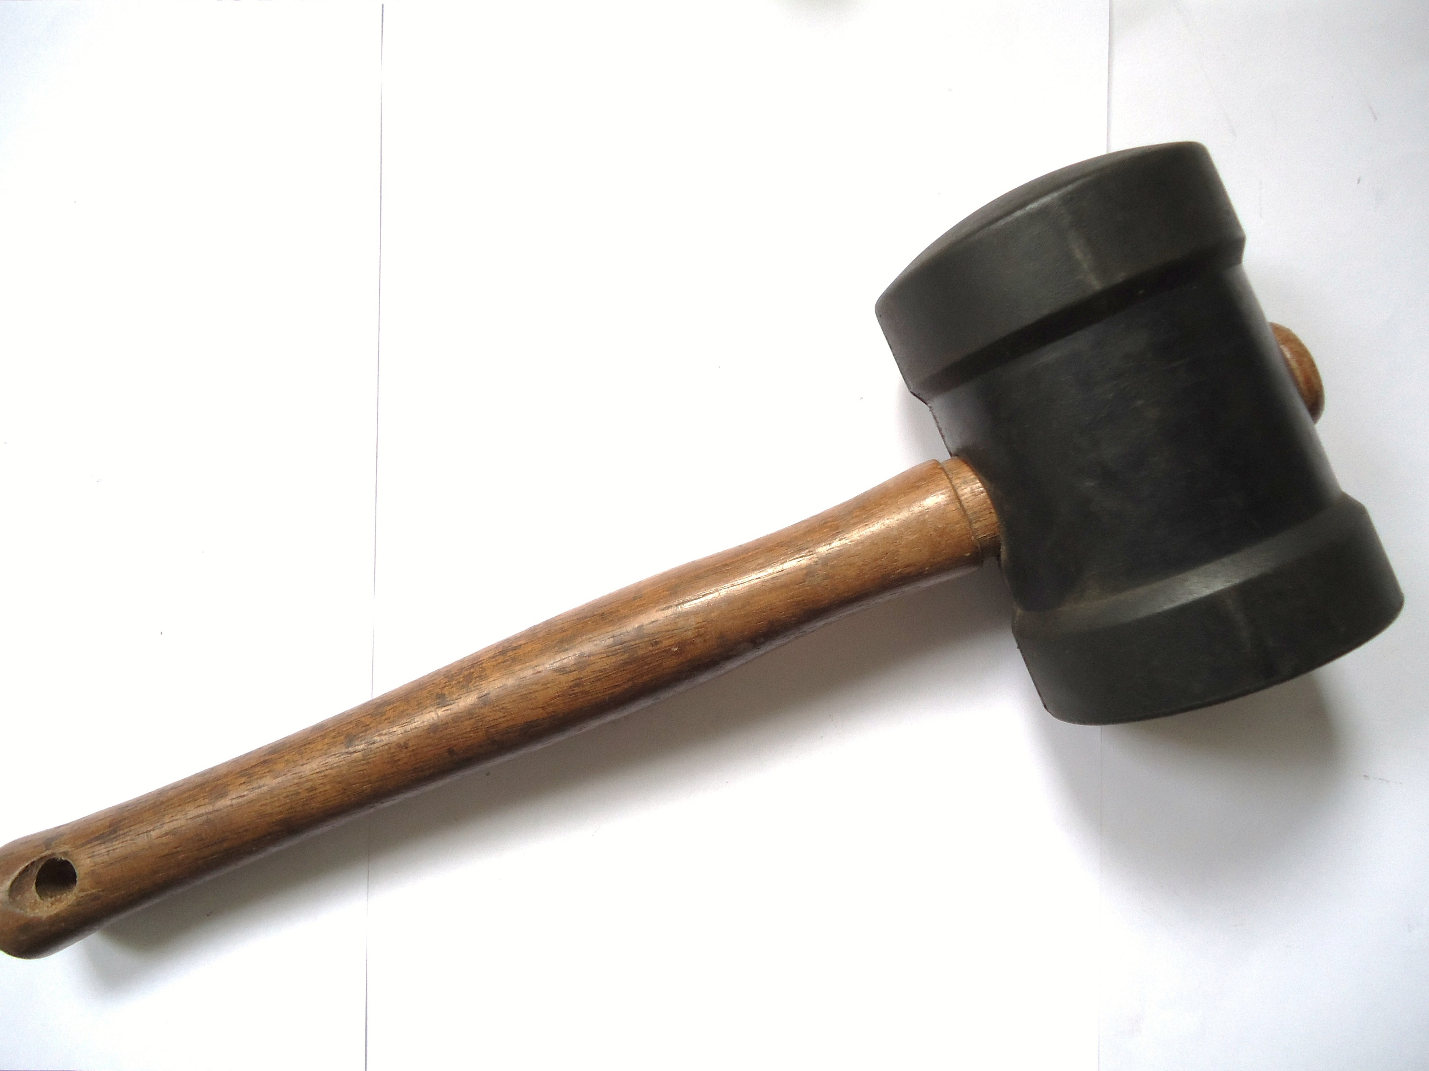
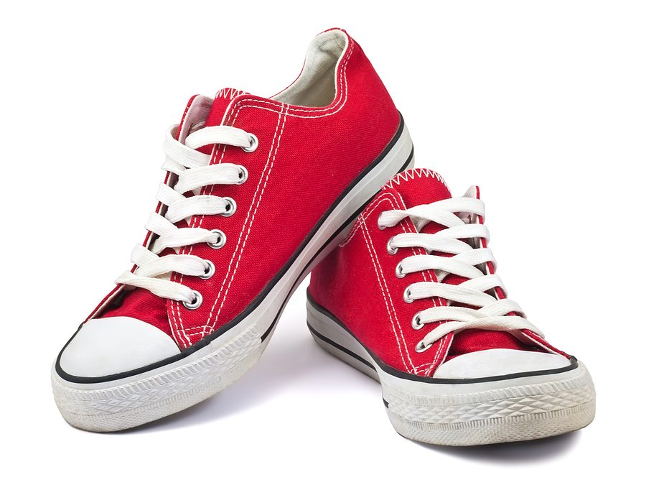
7 categories of emotions (every emotion you can think of will fall under one of these 7 main categories)
1) 5)
2) 6)
3) 7)
4)

Slide 19
Managing Emotions
7) Defense mechanisms- mental processes that protect individuals from strong or stressful emotions and situations.
1) repression- involuntary pushing of unpleasant feelings out of conscious thought.
2) Suppression- holding back or restraining, can provide temporary escape from an unpleasant situation.
3) rationalization- making excuses to explain a situation or behavior rather than taking responsibility.
4) Regression- reverting to behaviors of a younger age, rather than dealing with the conflict in a mature manner.
5) Denial- The refusal to accept reality
6) Compensation- making up for weaknesses and mistakes through gift giving, money, hard work.
7) Projection- Attributing your own feelings or faults to another person or group (parents/friends)
8) Idealization- seeing someone else as perfect or ideal (well Michael Jordan believes this, so I do too).

Slide 20
3 minute review
Think to yourself about which emotion you think you a lot…. When in a tough situation, which defense mechanism would you say you show? (1 minute)
Discuss with a partner (1 minute each)

Slide 21
https://youtu.be/dOkyKyVFnSs

