Slide 1
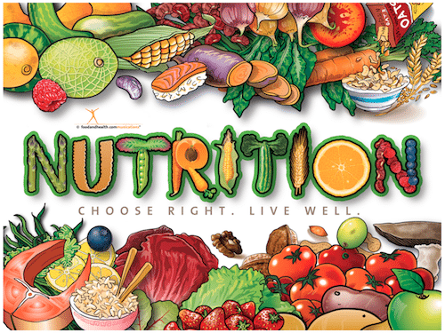
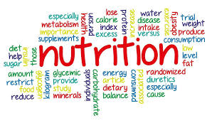
Nutrition
Chapter 5
This Photo by Unknown Author is licensed under CC BY-SA
This Photo by Unknown Author is licensed under CC BY-SA

Slide 2
Nutrition- the process by which the body takes in and uses the food we eat.
Nutrients- are substances in food that your body needs to grow, to repair itself, and to supply you with energy.
Calories- are the units of heat that measure the energy used by the body and the energy that foods supply to the body.
(A calorie is a unit of measurement — but it doesn't measure weight or length. A calorie is a unit of energy. When you hear something contains 100 calories, it's a way of describing how much energy your body could get from eating or drinking it.)
Everyone’s calorie intake is different- Let’s go find out how many calories YOUR body needs a day.
https://www.calculator.net/calorie-calculator.html

Slide 3
Why we choose the foods we eat…
Taste, of course plays a huge role in choosing the foods we eat.
Hunger- the NEED for food (your body physically needs food)
Appetite- is the desire for food.
Americans eat THEIR WEIGHT in sugar each year (includes added sugars to food).

Slide 4
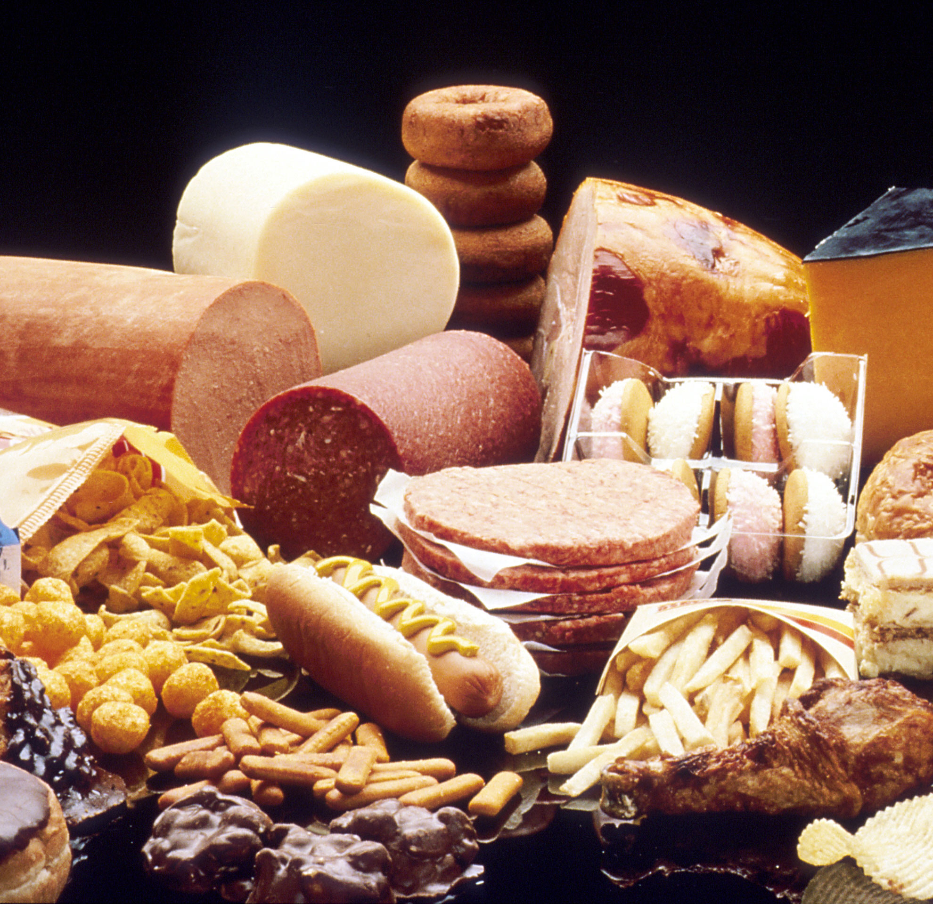
Nutrients- 6
1) Carbohydrates- starches and sugars found in food (breads, pastas, cereal, bagels, tortillas, chips)
The body’s # 1 source of energy 4 calories per gram
Glucose- blood sugar, to be used immediately
Glycogen- converted glucose, stored in muscles
Fiber- an indigestible complex carbohydrate that is found in the tough, stringy parts of vegetable, fruits and whole grains. (celery, fiber1 bars, activia…aka helps you poop)
This Photo by Unknown Author is licensed under CC BY-SA

Slide 5
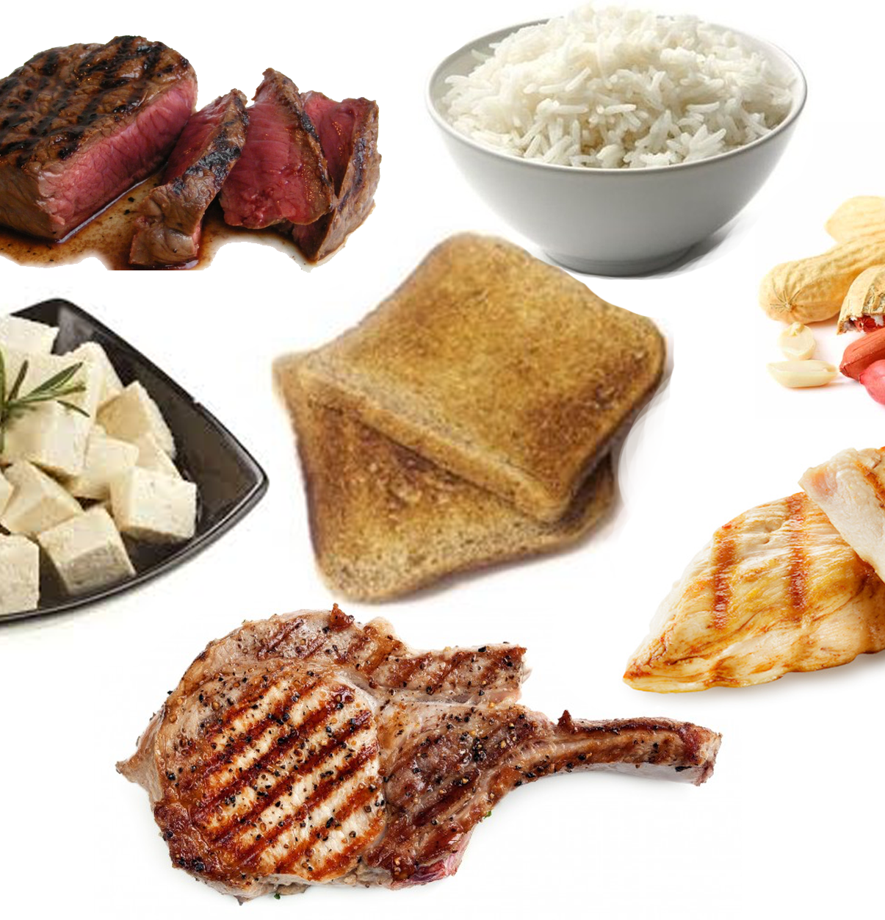
2) Protein- Helps build and maintain muscle. Made up of amino acids. “The building blocks of life”; found in every body cell (animal products, fish, poultry, cheese).
The body’s #2 source of energy 4 calories per gram
Amino acid- there are 20 amino acids. 11 of them are made by your body (thanks body!), the remaining 9 must come from the foods we eat.
Complete protein- is a food product that contains all 9 essential AA’s (animal products, meat, eggs, dairy)
Incomplete protein- a food that does not contain all 9 essential AA’s (beans, nuts, legumes)
This Photo by Unknown Author is licensed under CC BY-SA-NC

Slide 6
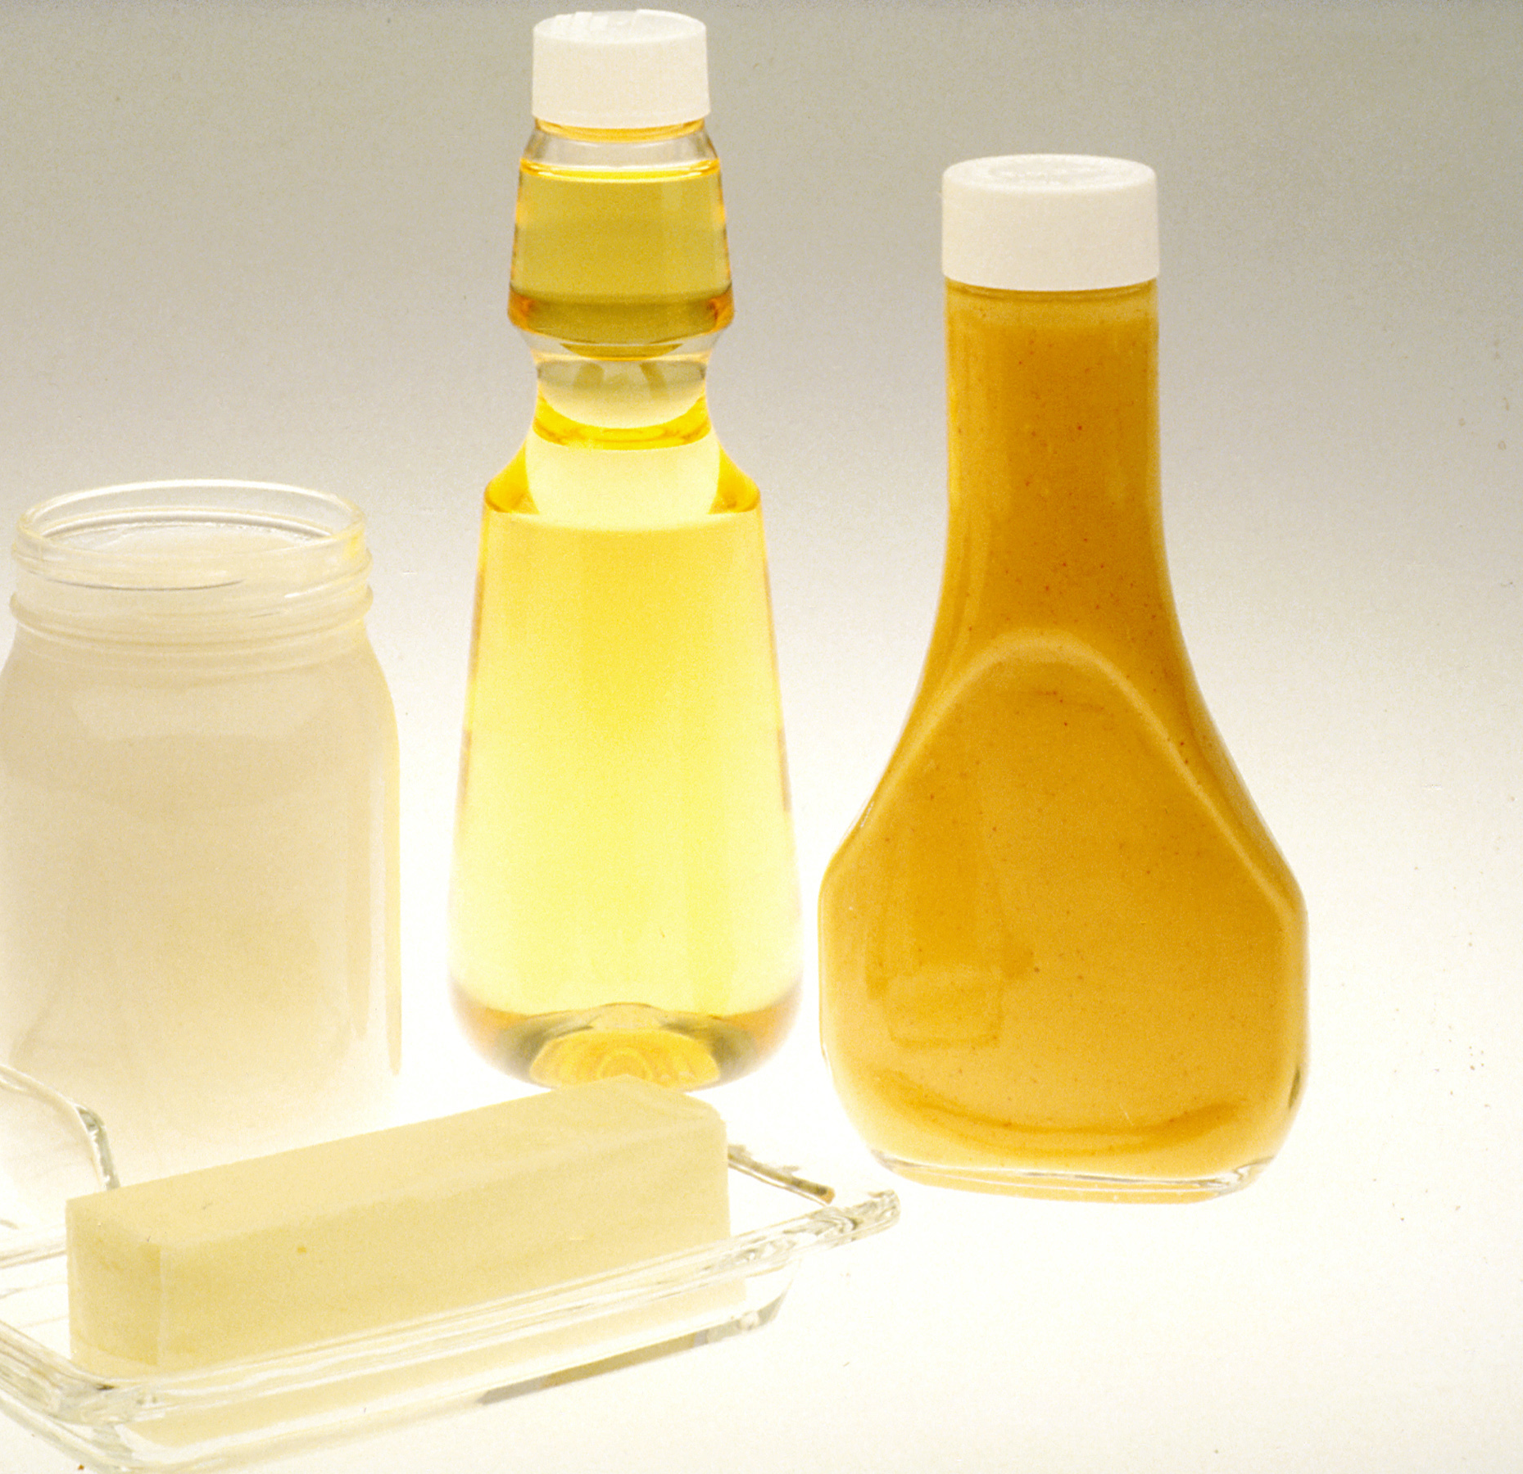
3) Fats- scientifically called “lipids”- a fatty substance that does not dissolve in water.
The body’s #3 source of energy 9 calories per gram
Unsaturated fat- liquid at room temperature (when you cook vegetables, what is left in the pan? Water, not oil)
Saturated fat- solid or semi solid at room temperature (pork fat)
Cholesterol- a waxy, fat-like substance, that your body produces.
It is a health concern because some people produce more cholesterol and then have added cholesterol through saturated fats and foods, which can cause some major health problems.
High cholesterol does run in families and is usually treated through life long medication.
This Photo by Unknown Author is licensed under CC BY-SA

Slide 7
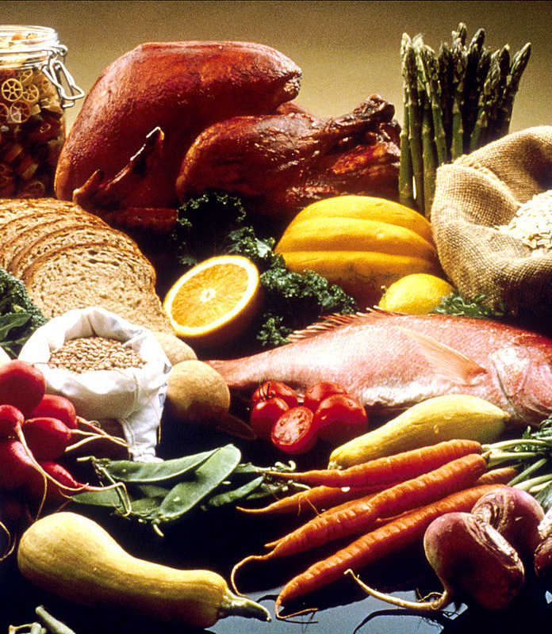
4) Vitamins- compounds that help regulate many vital body processes, including digestion, absorption and metabolism of other nutrients.
Water soluble- dissolve in water and pass easily into the blood during digestion. The body does not store these vitamins, so they need to be replenished regularly through the foods we eat.
Fat soluble- are absorbed, stored and transported in fat. Your body stores these vitamins in your fatty tissue, liver and kidneys.
Excess build up of these vitamins in your body can be toxic.
This Photo by Unknown Author is licensed under CC BY-SA

Slide 8
Water soluble vitamins
Fat soluble vitamins
Vitamin C (citrus fruits, tomatoes, cabbage, peppers)
B1 (thiamine) (liver, nuts, whole-grain enriched cereals)
B2 (riboflavin) (milk, cheese, spinach, eggs)
Niacin (milk, eggs, poultry, peanut butter, whole grains)
B6 (wheat bran, liver, meat, fish, veggies)
Folic Acid (nuts, OJ, green veggies)
B12 (animal products, fish, poultry, eggs, milk)
Vitamin A (milk, dairy products, green veggies)
Vitamin D (the sun, eggs, sardines, salmon, beef)
Vitamin E (vegetable oils, apples, peaches, nuts, seeds)
Vitamin K (spinach, broccoli, eggs, liver, cabbage, tomatoes)

Slide 9
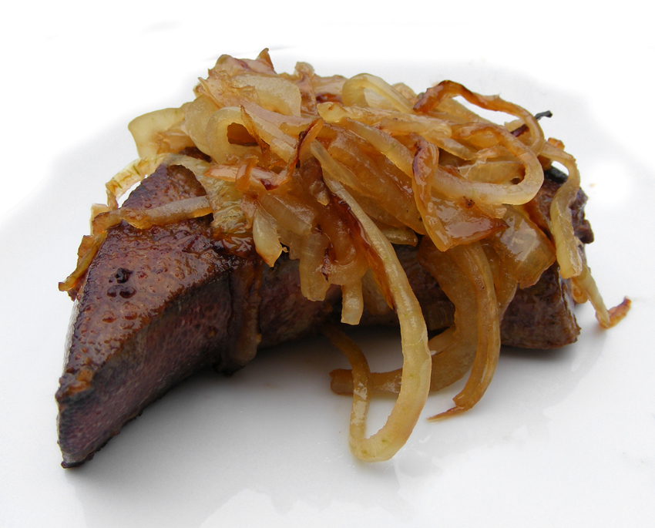
Minerals- are substances that the body cannot manufacture but are needed for forming healthy bones and teeth and for regulating many vital body processes.
Calcium- dairy products, leafy veggies, tofu
Phosphorous- milk and other dairy products, beans, liver, meat, fish, poultry
Magnesium- whole grains, milk, dark green leafy veggies, nuts
Iron- meat, shellfish, poultry, peanuts, dried fruits, egg yolks
This Photo by Unknown Author is licensed under CC BY-NC-ND

Slide 10
Water- ESSENTIAL to life. Helps lubricate joints, eliminate wastes.
NO nutritional value (this is a good thing)
Our bodies are 70-85% water

Slide 11
Extra vocab
Food additives: substances intentionally added to food to produce a desired effect (may be used to enhance a food’s flavor or color or lengthen its storage life).
Food Allergy: is a condition in which the body’s immune system reacts to substances in some foods.
Food intolerance: is a negative reaction to a food or part of food caused by a metabolic problem, such as the inability to digest parts of certain foods or food components. (i.e. lactose intolerant, gluten intolerant)
Foodborne illness- or food poisoning, may result from eating food contaminated with pathogens (disease-causing organisms).
Pasteurization- is the process of treating a substance with heat to destroy or slow the growth of pathogens.
Cross-contamination- the spreading of bacteria or other pathogens from one food to another. (wash your hands, cutting boards, utensils, playes and countertops with hot soapy water after preparing each item).

