Slide 1
Peer Relationships
Chapter 12

Slide 2
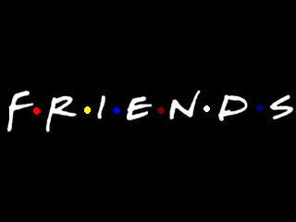
Questions to ponder…..
How would you describe your group of friends? Describe how your friends influence the way you act or feel.
Why do you choose the friends you have?
Why should you choose the friends that you have?
This Photo by Unknown Author is licensed under CC BY-SA

Slide 3
Peers- people of similar age who share similar interests.
As you get older the dynamics of your social groups change, this is natural.
Friendship- a significant relationship between two people.
Healthy friendships are based on caring, respect, trust, and consideration.
Platonic friendship- is a friendship with a member of the opposite gender in which there is affection (you care about them), but the two people are not considered a couple.
Think of some positives for having platonic friendships
Casual friends- peers who share something in common (same grade, same school, in some of your classes)
Close friends- have strong emotional ties and feel comfortable sharing their thoughts, experiences and feelings.

Slide 4
True friends:
Have similar interests, beliefs, and attitudes on basic issues
Have open and honest communication
Share joys, disappointments, dreams and concerns
Show mutual respect, care and support
Show concern about each other’s safety and well-being
Did this list make you re think some of your friends? Keep in mind, as you grow, our likes, opinions, beliefs can change and draws us apart.

Slide 5
Cliques and Groups
A clique is a small circle of friends, usually with similar backgrounds or tastes, who EXCLUDE people viewed as outsiders.
Groups- is a number of persons being in some relation to one another (common interests/hobbies), but INCLUDE others and usually a part of many groups.
Unlike a group of friends, cliques usually do not socialize outside of their group. Instead, they do everything together including eating lunch together, sitting together in class and hanging out together after school.
Do we have cliques and groups at our high school? Do you see the difference???
This Photo by Unknown Author is licensed under CC BY-SA

Slide 6
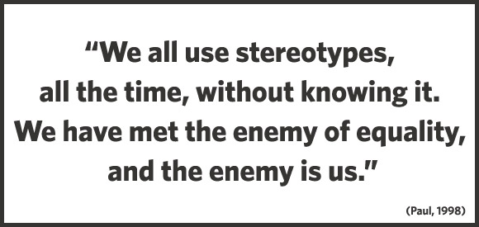
Stereotype- is an exaggerated and oversimplified belief about an entire group of people, such as an ethnic or religious group or a gender.
Ex: ALL girls like to go shopping, or ALL boys play video games (I know plenty of girls who do not! And I know a lot of boys who do not like and do not play video games!)
And even though a statement might seem true, saying that ALL of anything, is not fair or correct. That is a stereotype.
This Photo by Unknown Author is licensed under CC BY-NC-ND

Slide 7
Peer Pressure and Refusal Skills
Peer pressure- The influence that people your age may have on you.
Can be positive peer pressure or negative peer pressure
Think of some examples of POSITIVE peer pressure
Negative peer pressure can include:
Harassment- persistently annoying others. May include name calling, teasing, bullying.
Manipulation- an indirect, dishonest way to control or influence others.
Common Methods of Manipulation:
Mocking or teasing another person in mean or hurtful ways.
Using “guilt trips” to get desired results
Bargaining- offering to make a deal to get what one wants
Using flattery or praise to influence another person
Bribing- promising money or favors if the person will do what is asked
Making threats-promising violence or some other negative consequence
If the person does not do what is asked.
Using blackmail- threatening to reveal some embarrassing or damaging
Information if the person does not do what is asked.

Slide 8
Refusal Skills- are communication strategies that can help you say no when you are urged to take part in behaviors that are unsafe, unhealthy, or that go against your values.
Step 1- State your position: the first step in resisting negative peer pressure is to say no. Say is simply and firmly, make sure your “no” sounds like a NO. You can give a reason why ex “ it goes against what my values”.
1
Step 2- Suggest alternatives: if you are in an uncomfortable situation, offer an alternative activity.
2
Step 3- Stand your ground: even after you say no, peers will often continue trying to persuade you. Make it clear that you mean what you have said. Stand up for yourself.
3

Slide 9
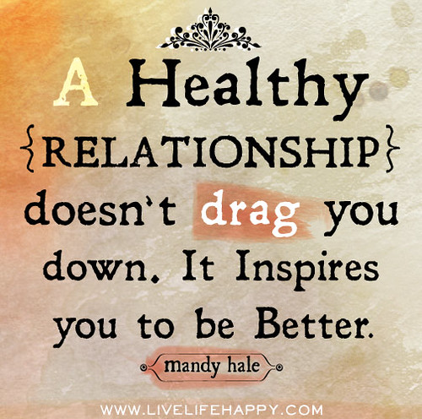
Dating and Setting Limits- lets talk about our brains (boys vs girls)
Characteristics of healthy dating relationships:
Attraction, closeness and commitment
Individuality
Balance
Open communication, honesty and respect
Support
Love
NOT Infatuation (exaggerated feelings of passion for another person)
Affection- a feeling of fondness for someone
Physical intimacy (no this is not just talking about sex!)
Safety

Slide 10
Group Dating
Why is group dating a good idea in general?
As a class, lets make a list on some great CHEAP group date ideas…. You’re Welcome! ☺

Slide 11
Signs of an Unhealthy Relationship
Your relationship is unhealthy if any of the following scenarios have occurred:
You endure angry outbursts
You feel you cannot say anything right
You feel you are constantly fighting
You are made fun of or threatened
Your partner is possessive or extremely jealous
Your partner tells you to stay away from your friends or family
Your bf or gf has raised a hand as if to hit you.
You have been slapped, choked, kicked, or otherwise physically assaulted.
You have been pressured or coerced into having sex.
Abstinence- a deliberate, on purpose, decision to avoid high risk behaviors, including sexual activity before marriage and the use of tobacco, alcohol, and other drugs.
Making excuses for this behavior is a sure sign that something is wrong…

Slide 12
Strategies for Forming Healthy Dating Relationships
Get to know the person you might want to date, I know it’s a weird concept! But know them BEFORE you call them your bf or gf…
Go out with a GROUP that includes the person you are interested in. AKA Group dating
Find ways to cope with your nerves… avoid those incredibly awkward situations…
If you DO decide to “date”, “go out”, “go courting”, “bf/gf”…set limits and avoid risky situations!
Story time!

