Slide 1
Family Relationships
Chapter 11

Slide 2
Questions to ponder: please write down your thoughts on a paper in front of you..
Make a list of qualities that you believe makes a healthy family
2) How are family relationships different than friend relationships?
3) What are some events that can change a family dynamic?
4) How should healthy families deal with conflict?
5) Individually think of the most impactful person in your life, as a group make a list. What makes them so important/impactful to you?

Slide 3
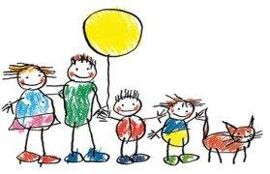
Family- the basic unit of society, should provide a safe and nurturing environment for its members.
Healthy family freely expresses mutual love and respect.
Communicate effectively with one another
Provide support and encouragement
Immediate family- the people who live in your household (parents, siblings)
Extended family- everyone else (grandparents, aunts, uncles, cousins)
Sibling- a brother or sister
??How can your relationship with your family affect your health triangle?
This Photo by Unknown Author is licensed under CC BY-SA-NC

Slide 4
Strengthening Family Relationship
Good communication (are you and your parents different colors when it comes to the personality test?)
Demonstrate care and love
Affirmation- positive feedback that helps others feel appreciated and supported.
Show support, especially during difficult times.
Demonstrate trust respect individuality
Express commitment work together to solve problems
Be responsible are sensitive to others’ needs
Spend time together

Slide 5
Change in Family Structure
Minor problems and irritations are normal when people are living together. Usually, good communication and problem-solving skills can help family members work out such conflicts.
Significant changes however, can have negative effects on the health of a family.
It is important that all family members develop coping skills and know strategies for managing stress

Slide 6
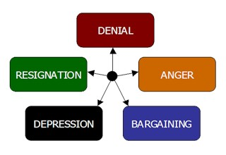
Separation- a decision between married individuals to live apart from each other.
Divorce- a legal end to a marriage contract
Custody- a legal decision about who has the right to make decisions affecting the children in a family.
Remarriage
Step siblings/parents
Death
Grief- the sorrow caused by the loss of a loved one
Moving
Financial problems
Illness and disability
Drug and alcohol abuse
Losing a job

Slide 7
Coping with Family Changes
It is important to manage the stress caused by family changes. Do not hold it in.
Do what you can to help- maybe help with chores around the house to alleviate stress from parents.
Read books about the subject or talk to people who have faced a similar problem.
Use stress management techniques
Physical activity sleep eat nutritious foods
Find a way to relax breathing techniques listen to music
Journal find a healthy hobby

Slide 8
Resiliency
Resiliency is the ability to adapt effectively and recover from disappointment, difficulty or crisis.
1
Resilient people can call upon their own strengths to deal with changes
2
Resilient families pull together to cope with changing circumstances
3

Slide 9
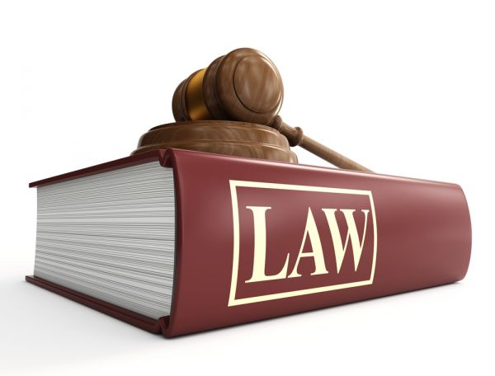
Dealing with Family Crises- tough stuff that may be difficult to discuss
Some families experience problems that can interfere with the normal, healthy conduct of family life.
Domestic violence- any act of violence involving family members. It is a criminal act that CAN be prosecuted by law.
Violence can by emotional, physical or sexual.
Emotional abuse- a pattern of behavior that attacks the emotional development and sense of worth of an individual.
Yelling, bullying, name-calling, threats of physical harm
Physical abuse- the intentional infliction of bodily harm or injury on another person.
Slapping, punching, kicking, pinching, throwing objects at another person
Sexual abuse- any sexual contact that is forced upon a person against his or her will. Includes making UNWELCOME comments of a sexual nature to another person as well as touching the person in an UNWELCOME sexual way.

Slide 10
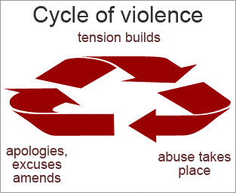
Child abuse- domestic abuse directed at a child
Neglect- the failure to provide for a child’s physical or emotional needs.
Physical needs include adequate food, clothing, shelter and medical care.
Emotional neglect may take the form of withholding love and support.
Cycle of violence- pattern of repeating violent or abusive behaviors from one generation to the next.
Breaking the cycle of violence:
Tell a trusted adult
Contact an abuse hot line or crisis center
Report the abuse to the police
Must be aware! And be willing to make the change!

Slide 11
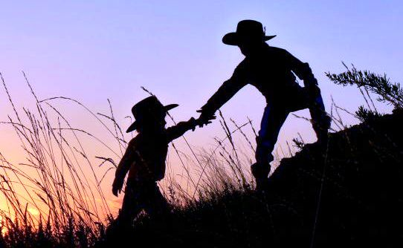
Community Support Systems
Crisis center- a facility that handles emergencies and provides referrals to an individual needing help.
Foster care- a temporary arrangement in which a child is placed under the guidance and supervision of a family or an adult who is not related to the child by birth.
shelters
Support groups
Churches
Mediation
Counseling

