Slide 1
Alcohol
Chapter 22

Slide 2
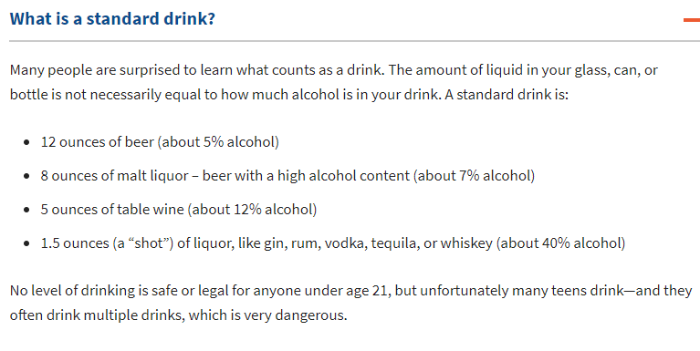

Slide 4
facts about alcohol
Alcohol is also known as ethanol, the type of alcohol in alcoholic beverages.
Alcohol can be produced naturally through fermentation (the chemical action of yeast on sugars)
Ethanol is powerful and addictive
Can be produced synthetically or naturally.
Alcohol is a depressant, a drug that slows the central nervous system down
Alcohol causes intoxication, the state in which the body is poisoned by alcohol or another substance and the person's physical and mental control is significantly impaired.
About 40% of violent crimes (3 million/year), are alcohol related
2/3 of victims that encounter domestic violence report that alcohol was a factor in the crime.
Nearly half of all homicide victims have alcohol in their bloodstream
Video on Alcohol
Does is add up?
Alcohol and the teenage brain

Slide 5
Factors that influence alcohol use
Peer Pressure- choose your friends wisely, this will help when it comes to uncomfortable situations!
Family- Parents can be a great resource to help you stay alcohol free!
Belonging to sports- Drinking alcohol will greatly impair your ability to participate in sports.
Media Messages- This causes many problems by showing alcohol as fun and exciting, it is not always like what TV and movies show us.

Slide 6
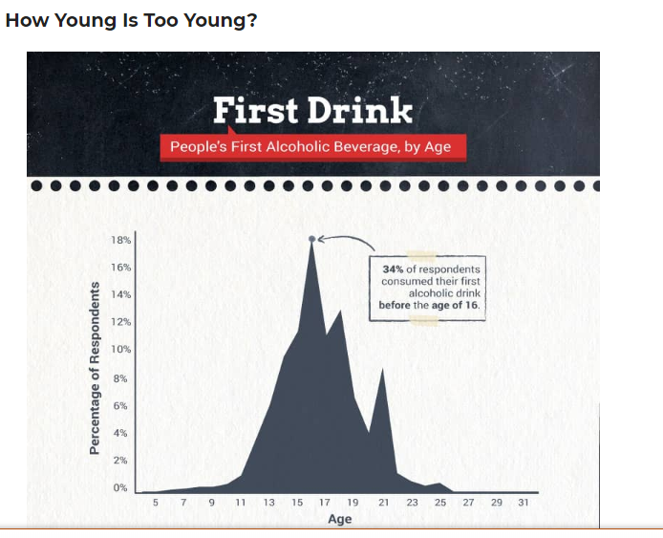

Slide 9
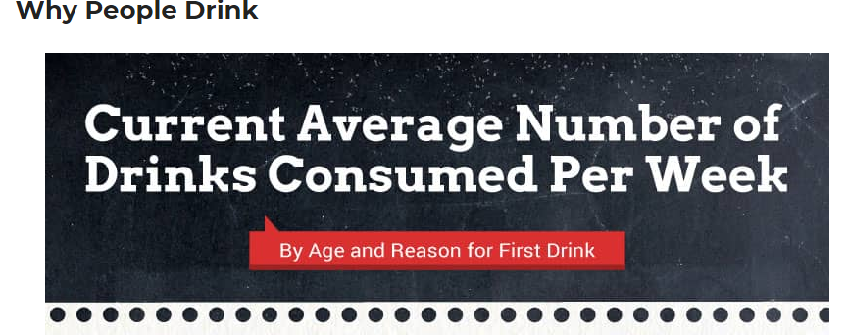
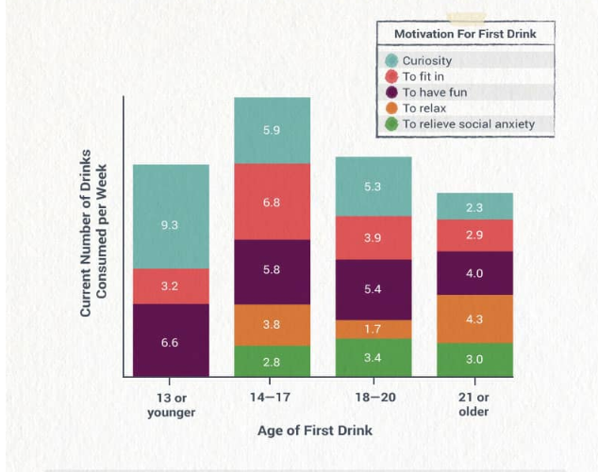

Slide 10
Alcohol’s role in Unsafe Situations
Teens who drink are more likely to be victims or perpetrators of
Rape
Aggravated assault
Robbery
Sexual activity at a younger age leading to unplanned pregnancy, HIV, STD’s and negative mental/social consequences.
It is illegal to buy, possess or consume alcohol before the age of 21.
You can be arrested, fined, and sentenced to juvie.
Many teens don’t see alcohol abuse (the excessive use of alcohol) at home but those who do are at a high risk for:
Neglect
Abuse
Economic hardship
Social Isolation

Slide 11
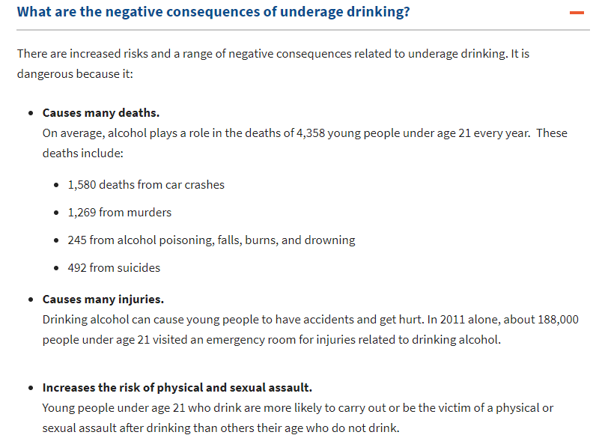
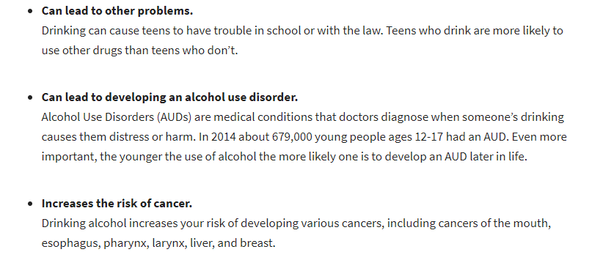

Slide 12
Benefit’s of being alcohol free
Maintain a healthy body
Reduces chance of injury and internal damage to organs/body systems
Make responsible decisions
You are able to make decisions that protect your health and the health of others
Avoid risky behavior
Reduce the risk of drinking and driving
Reduce the risk of unsafe sex
Of being a victim of a violent crime
Avoid illegal activities
Avoid legal problems

Slide 13
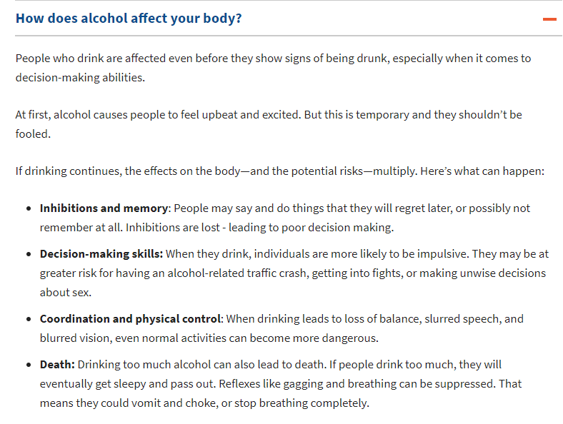
How does alcohol affect your body?

Slide 14
Short term effects of drinking
Body size and gender
A smaller person will feel the effects of the same amount of alcohol as a larger person does.
Generally alcohol flows through a females blood stream fast than a male.
Food
Eating food while consuming alcohol slows down the passage of alcohol through the bloodstream.
This can be helpful but also dangerous since you may not feel the affects of the alcohol until you have increased your consumption, risking alcohol poisoning.
Amount and rate of intake
Increased consumption = increased level of alcohol in your bloodstream
If you consume faster than your liver can break it down, you reach the level of intoxication
A high level of intoxication can lead to alcohol poisoning.

Slide 15
Alcohol and drug interactions
Drinking alcohol while taking medications can lead to:
Illness
Injury
Death
Alcohol-drug interactions make up ¼ of the emergency room admissions
Your body metabolizes the drug you take.
Your metabolism is the process by which the body breaks down substances.
Alcohol travels through your bloodstream to your brain and slows it down
The liver and kidneys metabolize the alcohol so your body can get rid of it through urine.
Combining drugs and alcohol can lead to
Accidents
Crime
Death

Slide 16
Alcohol and drug interactions
Alcohol can slow down a drug’s absorption by the body
Frequent drinking can increase your body’s metabolism which causes your body to break down the medication faster lessening the effectiveness of the medication.
Taking Tylenol with alcohol can cause serious damage to the liver even if it is in small amounts.
Alcohol can increase the effects of some drugs such as cold or allergy medicine. The interaction between these two can cause excessive dizziness and sleepiness which makes driving or operating machinery very dangerous.

Slide 17
Driving while intoxicated
Alcohol impairs your vision, reaction time and coordination and often times results in death.
Driving while under the influence also known as DWI is the leading cause of teen death.
Blood Alcohol Concentration (BAC)- the amount of alcohol in the person’s blood, expressed as a percentage.
BAC in many states must be under 0.1%, however you can feel intoxicated when your BAC is at 0.02%
Drinking of any sort:
Slows reflexes
Reduces your ability to judge distances and speeds
Increases risk-taking behaviors
Reduces a person’s concentration whole increasing forgetfulness.
Harm to the driver and others
Severely restricted driving privileges and/or immediate confiscation of a driver’s license.
Alcohol-related injuries, property damage, and death

Slide 18
Driving while intoxicated continued….
Loss of parental trust and respect
Arrest, jail time, court appearance, and a heavy fine or bail
A police record and possible lawsuits
Significantly higher insurance rates
Dozens of teens are killed each day by even being a passenger in a car of an intoxicated driver.
Binge drinking is when you drink 5 or more alcoholic drinks at one sitting.
Rapid binge drinking can lead to a fatal dose of alcohol causing alcohol poisoning.
Alcohol poisoning is a severe and potentially fatal physical reaction to an alcohol overdose
Effects of alcohol poisoning:
Passing out
Confusion, coma, vomiting (causing dehydration), seizures
Slow respiration rate, irregular heart rate
Death

Slide 19
Alcohol, the individual, and society
The Science (and Dangers) of Booze in Humans
Long-Term effects of Alcohol
Changes in the brain
Addiction (inability to stop), loss of brain function, brain damage
Cardiovascular Changes
Damage to heart, enlarged heart, high blood pressure
Liver problems
Fatty liver (a build up of fat on the liver that cannot be broken down), alcoholic hepatitis (inflammation or infection of the liver), cirrhosis (healthy tissue replaced with scar tissue)
Digestive system problems
Pancreas problems

Slide 20
Alcohol and pregnancy
When a pregnant mom drinks, the fetus does too! Fetus livers cannot process alcohol causing permanent damage to the fetus.
Fetal Alcohol Syndrome (FAS)- a group of alcohol-related birth defects that include physical and mental problems.
Fetal Alcohol Syndrome can cause:
Born with a small head
Deformities to the face, hands and feet
Heart, liver and kidney defects
Vision and hearing problems
Slow growth, coordination
Have learning disabilities such as inability to focus, poor memory and problem solving
Leading cause for mental retardation in the U.S.
100% PREVENTABLE

Slide 21
Alcoholism
Alcoholism- a disease in which a person has a physical or psychological dependence on drinks that contain alcohol. This is characterized by the inability to work, study and socialize properly.
Alcoholism is not related to a certain age, race, gender, ethnic or socioeconomic group of people.
Many people who have alcoholism are considered alcoholics- someone who is dependent on alcohol.
Alcohols often times display risky behaviors such as drunk driving, violent/aggressive actions, withdrawn.
Alcoholics often times have these characteristics:
Cravings for alcohol
Loss of control
Physical Dependence
High tolerance
Health, family and/or legal problems

Slide 22
Alcoholism Cont…..
Stages of alcoholism
Abuse- a physical and psychological dependence on alcohol to manage stress develops, lies or makes excuses about their drinking, needs to consume more alcohol to feel desired effects.
Dependence: They cannot stop drinking, physically dependent, it’s their central focus, tries to hide the problem, job performance, school and home life suffer, makes excuses or blames others.
Addiction: Alcohol becomes the most important thing in their life, they cannot control their desires, high liver damage which creates the need for less alcohol to reach intoxication, would experience severe withdrawal symptoms if they stopped.
Treatment
Cannot be cured, but can be treated!
Recovery-The process of learning to live an alcohol-free life
Sobriety- living without alcohol. A LIFELONG COMMITMENT!

